Slide 1
Sustainability in Logistics:
Transport Policy Frameworks
Notes:
Today, we will focus on the topic of transport policy. We will begin with an overview of today’s contents and then delve deeper into the fundamentals and strategies. In addition, we will take a closer look at modal shift, including its potential and challenges.

Slide 2
Agenda
Sustainability in Logistics
European Transport and Climate Policy
Austrian Transport and Climate Policy
Transport Policy – Fundamentals

Slide 3
Sustainability in Logistics

Slide 4
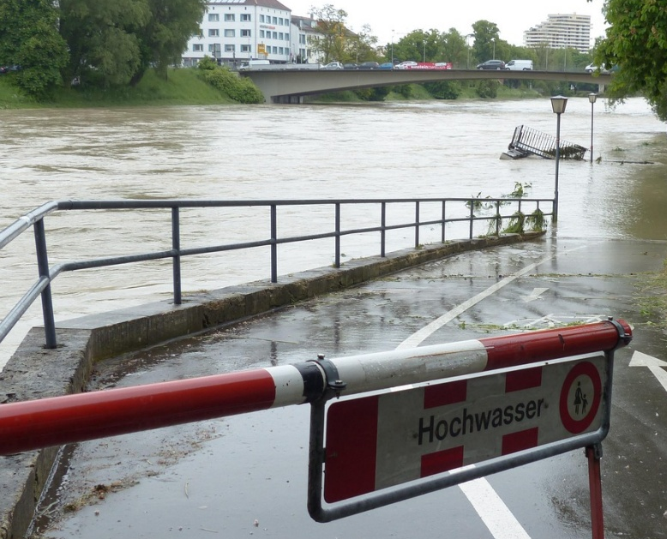



Activity: Climate change and global warming
Pictures: Pixabay
Notes:
Introductory Activity on Climate Change:
The images serve as inspiration for a warm-up discussion on climate change and global warming in class or small groups. The consequences and facts of global warming are presented on the next slide.
Duration: approx. 10 minutes
Social format:
Small group work (2–4 people) or class discussion
Optional: Individual reflection at the beginning (e.g. using a short writing prompt)
Guiding questions for the discussion:
What do you see in the images, and how do these effects relate to climate change?
How can we personally feel the impact of climate change?
Which regions and people are especially affected?
What feelings or thoughts do the images evoke in you?
Learning objectives:
Students recognize visual signs and impacts of climate change.
Students identify connections between global environmental changes and climate change.
Students share personal perceptions and global perspectives.
Students develop an initial awareness of the urgency of climate-related challenges.
Images sources:
Pixabay (2025): https://pixabay.com/de/photos/hochwasser-stra%C3%9Fe-gesperrt-schaden-123218/ (Accessed: 12.02.2025)
Pixabay (2025): https://pixabay.com/de/photos/klimawandel-thermometer-waldbrand-3836835/ (Accessed: 27.02.2025)
Pixabay (2025): https://pixabay.com/de/photos/wasserhahn-installation-tippen-2151449/ (Accessed: 12.02.2025)
Pixabay (2025): https://pixabay.com/de/photos/eis-gletscher-schmelzen-klimawandel-7678230/ (Accessed: 12.02.2025)

Slide 5
Greenhouse Gases
Greenhouse gases affect the Earth’s energy balance
Greenhouse effect, global warming
Most well-known greenhouse gases: carbon dioxide (CO₂), methane, and nitrous oxide
Low natural occurrence of greenhouse gases
Increase in greenhouse gases caused by human activity
Chart: own illustration based on EEA
Notes:
Greenhouse gases are gases in the atmosphere that intensify the greenhouse effect by influencing the Earth’s energy balance. Although carbon dioxide, methane, and nitrous oxide occur naturally in low concentrations, human activities have significantly increased their levels since the last century.
To make the climate impact of different greenhouse gases comparable and to define their warming potential, methane and nitrous oxide are often expressed in so-called CO₂ equivalents (CO₂e).
In 2021, greenhouse gas emissions in the EU amounted to approximately 3.5 billion tonnes of CO₂ equivalents.
In 2019, greenhouse gas emissions in the EU consisted of 80% carbon dioxide, 11% methane, 6% nitrous oxide, and 2% fluorinated hydrocarbons.
Chart based on the European Environment Agency (EEA):
European Parliament (2024): https://www.europarl.europa.eu/resources/library/images/20211027PHT16017/20211027PHT16017_original.jpg; accessed 18 March 2025
Sources:
DESTATIS (2024): https://www.destatis.de/Europa/DE/Thema/GreenDeal/_inhalt.html; accessed 18 March 2025
Myclimate (2024): https://www.myclimate.org/de/informieren/faq/faq-detail/was-sind-treibhausgase/; accessed 18 March 2025

Slide 6
CO₂ Equivalents (CO₂e) = Global Warming Potential
Carbon dioxide
Atmosphere
CO₂e is a unit of measurement that makes the climate effects of all greenhouse gases comparable
Different greenhouse gases contribute to the greenhouse effect to varying degrees and remain in the Earth’s atmosphere for different lengths of time
Methane (fossil)
Nitrous oxide
Sulfur hexafluoride
Nitrogen trifluoride
Fully fluorinated compounds, e.g. PFC-116
Fluorinated hydrocarbons, e.g. HFC-23
Image: Pixabay and own illustration, data from IPCC (2024)
Notes:
CO₂e is a unit of measurement that makes the climate impact of all greenhouse gases comparable: different greenhouse gases contribute to the greenhouse effect to varying degrees and remain in the Earth’s atmosphere for different lengths of time.
Example:
Comparison of the impact of one tonne of CO₂ with one tonne of methane over a period of 100 years: one tonne of methane is around 30 times more harmful to the climate than one tonne of CO₂. One tonne of methane therefore corresponds to approximately 30 tonnes of CO₂ equivalents (CO₂e).
Sources:
ClimatePartner GmbH (2025): https://www.climatepartner.com/de/wissen/glossar/co2-aequivalente-co2e (accessed 1 July 2025)
Image source:
Own illustration; Earth image from Pixabay (2025): https://pixabay.com/de/photos/erde-planet-raum-welt-universum-11009/ (accessed 1 July 2025); data from IPCC (2024a): https://ghgprotocol.org/sites/default/files/2024-08/Global-Warming-Potential-Values%20%28August%202024%29.pdf (accessed 1 July 2025)

Slide 7
The Transport Sector as a Source of Greenhouse Gas Emissions
The transport sector is responsible for 21% of global CO₂ emissions
Releases more than eight billion tonnes of CO₂ equivalents into the atmosphere each year
Emissions from this sector have almost doubled since 1990 and are expected to continue to rise
Road vehicles are by far the largest emission sources within the transport sector; in 2023, they accounted for three quarters of total transport-related CO₂ emissions
Chart: own illustration based on Statista
Notes:
Sources:
Janson (2025): https://de.statista.com/infografik/24799/prognose-zum-anstieg-der-globalen-durchschnittstemperatur/ (accessed 7 July 2025)
Image source:
Own illustration; data from Statista (2024a): https://de.statista.com/statistik/daten/studie/167957/umfrage/verteilung-der-co-emissionen-weltweit-nach-bereich/ (accessed 7 July 2025)

Slide 8
The Transport Sector in the EU
In 2023, the transport sector accounted for 25.2% of CO₂ emissions in the EU
Cars are the largest emitters in EU transport: in 2022, road vehicles in the EU emitted approximately 755 million tonnes of CO₂, accounting for three quarters of emissions in the transport sector
Chart: own illustration based on Statista
Notes:
Source:
Statista (2025b): https://www.statista.com/topics/7968/transportation-emissions-in-the-eu/#statisticChapter (accessed 7 July 2025)
Image source:
Own illustration; data from Statista (2024b): https://www.statista.com/statistics/1325132/ghg-emissions-shares-sector-european-union-eu/ (accessed 7 July 2025)

Slide 9
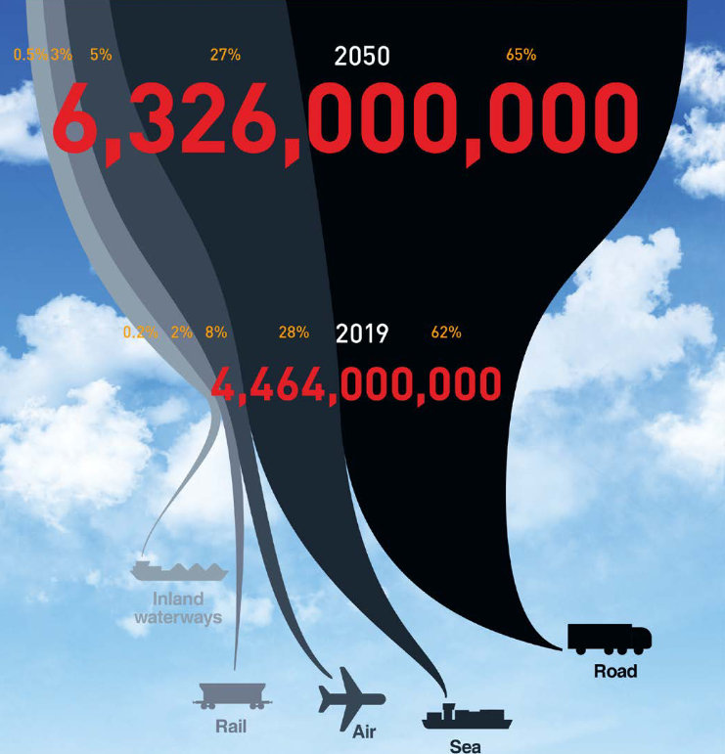
Traffic Forecasts
Transport emissions are rising sharply
Forecasts assume an almost doubling of freight transport by 2050 (compared to 2019)
In particular, road freight transport is increasing
Image: Smart Freight Centre
Notes:
The continued growth of freight transport, particularly road freight transport, has significant impacts on the environment and the climate. Forecasts assume an almost doubling of freight transport by 2050 compared to 2019 (cf. ITF 2023, p. 67).
Image source:
Smart Freight Centre (2024): GLEC Framework v3.1 edition, revised and updated. Available at: https://www.smartfreightcentre.org/en/our-programs/emissions-accounting/global-logistics-emissions-council/calculate-report-glec-framework/, p. 8.
Based on: ITF (2023): ITF Transport Outlook 2023, OECD Publishing, Paris. Available at: https://doi.org/10.1787/b6cc9ad5-en ; last viewed 25 September 2024.
Source:
ITF (2023): ITF Transport Outlook 2023, OECD Publishing, Paris. Available at: https://doi.org/10.1787/b6cc9ad5-en ; accessed 6 March 2025.

Slide 10
What Are External Costs of Transport?
Costs that are not borne by those who cause them, but by society as a whole
Pollutant emissions
Noise
Accident costs
Land use
Impacts on flora and fauna
Congestion costs
Notes:
Costs arising from mobility that are not borne by those who use transport are referred to as external costs of transport. These costs are shifted to third parties, such as taxpayers and future generations. The negative external effects of transport include, in particular, pollutant emissions, CO₂ emissions, noise emissions, accident-related costs, land use, and impacts on flora and fauna. External costs have significant societal and health impacts (e.g. quality of life, noise exposure, stress, and diseases) as well as environmental impacts (climate change and biodiversity loss).
These costs vary significantly depending on the mode of transport and underline the need to shift the modal split in favour of environmentally friendly alternatives.
Source:
Koch, Susanne (2012): Logistics – An Introduction to Economics and Sustainability, pp. 294–295

Slide 11
External Costs – Comparison of Transport Modes
Traffic congestion
Infrastructure
Climate costs
Air pollutants
Noise
Accidents
31
Cents per kilometre
21
15
10
Road Rail (diesel) Rail (electrified) Inland waterway vessel
ROAD RAIL (DIESEL) RAIL (ELECTRIFIED) INLAND NAVIGATION
Chart: own illustration based on Christidis / Brons
Notes:
Inland waterway transport and electrified rail generate by far the lowest external costs compared to road freight transport.
In 2023, the share of electrified rail lines across all infrastructure operators in Austria was approximately 75% (cf. Schienen-Control).
Across the EU-27, the electrification rate of rail networks in 2023 was 57.4% (cf. Eurostat 2025).
Sources:
Own illustration based on:
Christidis, P., & Brons, M. (2016): External costs of freight transport in European Union Member States (Joint Research Centre – JRC). Harvard Dataverse.
https://dataverse.harvard.edu/dataset.xhtml?persistentId=doi:10.7910/DVN/YA3VCY ; https://doi.org/10.7910/DVN/YA3VCY; accessed 28 January 2025
Eurostat (2025): https://ec.europa.eu/eurostat/statistics-explained/index.php?title=Characteristics_of_the_railway_network_in_Europe; accessed 6 March 2025
Schienen-Control (2025): https://www.schienencontrol.gv.at/de/wettbewerbsregulierung/eisenbahnnetz-oesterreich.html; accessed 28 January 2025

Slide 12
Sustainability and Green Logistics
Sustainability:
Sustainable development that meets the needs of the present generation without compromising the ability of future generations to meet their own needs.
Green Logistics:
A holistic transformation of the logistics sector aimed at creating environmentally friendly and resource-efficient logistics processes, ensuring a balance between economic and environmental efficiency.
Notes:
The concept of sustainability was first developed in forestry in the 18th century to prevent deforestation, although it had already been practiced regionally as early as the 15th century. Since the 1970s, there has been growing concern about how economic activities—particularly logistics—affect the environment and exploit and pollute natural resources. The term “sustainability” was coined to describe long-term development that meets the needs of the present generation without compromising the ability of future generations to meet their own needs. According to the Brundtland Commission, the needs of the present generation should not be met at the expense of future generations. Natural resources should only be used to the extent to which they can regenerate.
Environmental challenges require not only remedial protective measures but also proactive climate action through a fundamental rethinking within industrial societies. In the logistics and transport sector, “green logistics” is a commonly used term. It refers to the holistic transformation of logistics strategies, structures, processes, and systems in order to create environmentally friendly and resource-efficient logistics processes. The objective of green logistics is to achieve a balance between economic and environmental efficiency and to create sustainable corporate value.
Source:
Koch, Susanne (2012): Logistics – An Introduction to Economics and Sustainability, pp. 292 ff.

Slide 13
The Three Pillars of Sustainability in Logistics
Green Logistics
Economic
Environmental
Social
“…environmentally friendly and socially responsible, but also financially viable”
Notes:
The concept of green logistics seeks to achieve a balance between economic, environmental, and social objectives within the field of logistics, which also directly affects the transport sector. This results in trade-offs between these three dimensions, as not all objectives can be pursued simultaneously. The following goals can be assigned to each dimension:
Social objectives: Raising awareness of sustainable transport and ensuring a high quality of life.
Environmental objectives: Reducing emissions and, more generally, decreasing resource consumption.
Economic objectives: From a financial perspective, avoiding additional costs or achieving cost reductions, and minimizing inefficiencies (periods during which resources or processes are not productive).
Naturally, additional objectives can be assigned to each dimension, which makes achieving a balanced pursuit of goals across all areas even more challenging.
Sources:
Pazirandeh, Ali / Jafari, Hamid (2013): Making sense of green logistics. In: International Journal of Productivity and Performance Management, pp. 889–890.
Saroha, Rituraj (2014): Green logistics & its significance in modern day systems. In: International Review of Applied Engineering Research, p. 90.

Slide 14

Activity: Sustainability: Economy, Ecology, and Social Issues in Conflict
Critically question the three pillars of sustainability in three groups. What often doesn't work well in our world?
Discuss the guiding questions for each pillar.
Group 1: Economy – Sustainability vs. Profit
Group 2: Ecology – Save the environment, but how?
Group 3: Social – Sustainability for everyone?
Image: Flaticon
Notes:
Sustainability in Harmony – Economy, Ecology, and Social Aspects in Conflict
Duration: 1 teaching unit
Group discussion in three teams.
Each group is assigned one pillar of sustainability and discusses the following questions:
Group 1: Economy – Sustainability vs. Profit
Where do economic interests conflict with ecological or social goals?
Examples of companies or industries that do not act sustainably
Are there positive examples of sustainable business practices?
Group 2: Ecology – Saving the environment, but how?
Why are environmental goals often not achieved?
What challenges exist (e.g., climate protection, resource consumption, pollution, loss of biodiversity)?
Who is responsible – politics, businesses, or consumers?
Group 3: Social – Sustainability for everyone?
Where does our economic system lead to social injustice?
Which people or countries are particularly affected by unsustainable behavior?
Why is sustainable living difficult for many people to implement?
Joint Reflection in the Class:
How can we implement sustainability better in all areas?
What can we do as individuals or as a society?
Which of the three pillars is the hardest to achieve?
Possible Solutions / Input for Teachers:
Economy – Sustainability vs. Profit
Discussion: Is sustainable business compatible with making profits? Which companies are setting a good example?
Approaches:
Promote sustainable business models: Reward companies with environmental certifications or circular economy systems.
Introduce real prices ("true cost pricing"): Factor environmental and social costs into prices (e.g., CO₂ tax, plastic tax).
Laws & incentives for companies: Tax breaks for sustainable companies, stricter environmental regulations for polluters.
Change consumer behavior: Raise awareness for sustainable consumption (e.g., less fast fashion, more local products).
Ensure fair supply chains: Mandatory sustainability reporting for large companies.
Ecology – Saving the environment, but how?
Discussion: Why is it so hard to enforce environmental goals? Who’s responsible – politics, business, or consumers?
Approaches:
Promote environmentally conscious behavior: More education on sustainability in schools and companies.
Radically reduce CO₂ emissions: Expand renewable energy, increase CO₂ taxes, stricter emission standards.
Strengthen circular economy: More recycling, less waste, longer product lifespans (e.g., promote repairability).
Reward ecological action: Grants for sustainable businesses and subsidies for climate-friendly technologies.
Strengthen global cooperation: Environmental problems are global – international agreements and stronger enforcement needed.
Social – Sustainability for Everyone?
Discussion: Is sustainable living a luxury problem? How can sustainability be made socially fair?
Approaches:
Fair wages & working conditions worldwide: Enforce minimum standards for wages and working conditions.
Socially fair sustainability: Make eco-friendly products and services affordable for all.
Strengthen social safety nets: Improve access to education, healthcare, and fair work conditions.
Make urban planning & infrastructure more sustainable: More public transport, less car traffic, affordable housing.
Promote awareness: Campaigns and educational programs on sustainable consumption and fair production.
Additional Discussion Questions for the Groups:
What can individuals do – and where are politics & businesses needed?
Is a "green economy" even realistic, or are more radical changes needed?
Should companies be held liable for environmental and social damage?
Why is sustainability often perceived as expensive or impractical?
Which countries or sectors are leading the way in sustainable business?
Learning Objectives:
Students understand the three pillars of sustainability – economy, ecology, and social – and recognize their interdependence and potential conflicts.
Students critically evaluate business strategies and political measures in terms of their sustainability.
Students reflect on their own role as consumers and develop awareness of global responsibility.
Students apply critical thinking, work cooperatively in teams, and improve their ability to structure and present arguments persuasively.

Slide 15
What Makes a Mode of Transport Sustainable?
Ecological impact areas
Emissions
Social impact areas
Traffic safety
Economic impact areas
Transport costs
Land use
Specific energy consumption
Working conditions
Remuneration
Reliability
Transport duration
Noise
Punctuality
Notes:
At present, ecological factors (especially CO₂ emissions) and economic factors (transport costs) are the primary focus when assessing modes of transport.
Environmental protection is still often treated as a secondary consideration by many companies and is mainly used for marketing purposes. From a business economics perspective, environmental protection is also frequently viewed as an opportunity to reduce costs or increase revenues.
However, for a comprehensive comparison of transport modes from a sustainability perspective, additional factors beyond emissions and transport costs must be taken into account (see above). The assessment criteria shown in the figure within the three impact areas represent a selection of possible comparison factors and can, of course, be further expanded.
Source:
Pazirandeh, Ali / Jafari, Hamid (2013): Making sense of green logistics. In: International Journal of Productivity and Performance Management, pp. 889–890.

Slide 16
International Climate Targets
World Climate Conference 2015 in Paris, at which the Paris Agreement was adopted by 195 member states of the United Nations Framework Convention on Climate Change (UNFCCC).
The agreement sets the goal of limiting global warming to well below 2 °C—ideally to 1.5 °C—compared to pre-industrial levels.
Notes:
The Paris Climate Agreement – a milestone in global climate protection
The climate crisis is a global challenge that can only be addressed through international cooperation. A decisive step was the World Climate Conference in Paris in 2015, at which the Paris Agreement was adopted by 195 member states of the United Nations Framework Convention on Climate Change (UNFCCC).
The agreement sets the objective of limiting global warming to well below 2 °C—ideally to 1.5 °C—compared to pre-industrial levels. In addition, greenhouse gas emissions should be reduced to a level that can be absorbed by natural and technological CO₂ sinks. Another key element is financial support for poorer countries, enabling them to implement climate mitigation measures and adapt to the impacts of climate change.
Today, 198 countries are parties to the UNFCCC, 195 of which have signed the Paris Agreement—representing nearly the entire global community. Despite this broad consensus, the implementation of concrete measures often remains challenging due to differing national interests.
In addition to the Paris Agreement, there are further international initiatives aimed at advancing climate protection in industrialized, emerging, and developing countries, each with its own focus areas and members.
Sources:
Klimabündnis Österreich (2024): https://www.klimabuendnis.at/wp-content/uploads/2024/09/Praesentationen_zu_Klimafakten_Klimawandel.pdf (accessed 1 July 2025)
German Environment Agency – Umweltbundesamt (2024a): https://www.umweltbundesamt.de/themen/klima-energie/internationale-klimapolitik#internationale-klimapolitik (accessed 7 July 2025)

Slide 17
Transport Policy – Fundamentals

Slide 18
Methods for Influencing Freight Transport Mobility
Traffic avoidance / traffic reduction
  Measures and incentives to avoid and reduce traffic and transport demande.g. reduction of empty runs
Traffic optimization
  Optimization of transport performance, e.g. through the use of improved information and communication systems
    e.g. optimization through AI-based truck capacity utilization
Traffic shift (modal shift)
  Measures and incentives to shift traffic on a spatial basis (e.g. local driving bans),on a temporal basis (e.g. time-based driving bans), oron a mode-specific basis (e.g. more environmentally friendly modes of transport)
Notes:
To reduce the negative impacts of freight transport, three main approaches can be distinguished: traffic avoidance, traffic optimization, and traffic shift (modal shift).
Sources:
Kummer, Sebastian (2010): Introduction to Transport Economics. 2 volumes. Vienna: UTB, Facultas, WUV.
Wittenbrink, Paul (2015): Green Logistics. Wiesbaden: Springer Fachmedien Wiesbaden.

Slide 19
Pull vs. Push Measures
Push measures
focus on restrictions
e.g. tolls, CO₂ charges, driving bans
Pull measures
focus on supply / incentives
e.g. expansion of the rail network, subsidies
  Combination: creates incentives while simultaneously applying pressure to reduce climate-damaging options

Slide 20
Transport Policy Lab
Scenario: You are a policy expert team advising your country or an EU region.
Objective:👉 –40% CO₂ emissions in freight transport by 2040
Constraints / Framework Conditions:
Security of supply
Competitiveness of industry
EU Single Market / international logistics
Bild: Flaticon
Notes:
Duration: 1 teaching unit
Short activation:“Why is freight transport so difficult to decarbonise?”
Typical keywords (to be collected):
Just-in-time logistics
International value chains
Cost pressure
Lack of viable alternatives to road transport
Scenario: You are a policy expert team advising your country or an EU region.
Objective👉 –40% CO₂ emissions in freight transport by 2040
Constraints / Framework conditions
Security of supply
Industrial competitiveness
EU Single Market / international logistics
Further instructions: Please refer to the next slide for the detailed task description.
Learning objectives
Students …
distinguish between push and pull measures in freight transport
analyse impacts on costs, modal split and competitiveness
understand why policy mixes are unavoidable
learn to identify trade-offs between climate protection, economic performance and security of supply

Slide 21
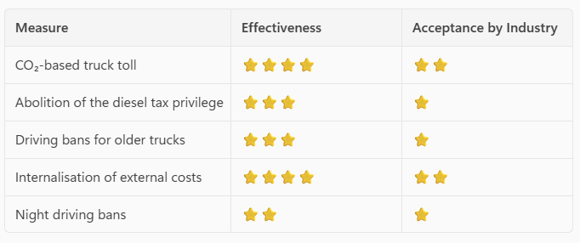
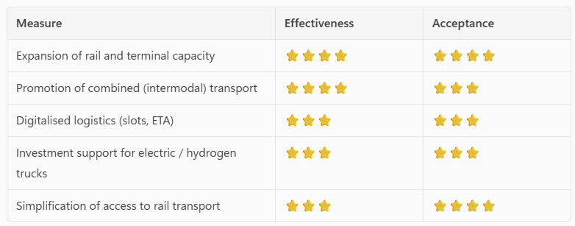
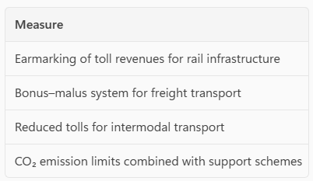
Activity: Policy Measure Cards
Push-Measures
Pull-Measures
Policy Mix Measures
graph: created using MS CoPilot
Notes:
Task
Select up to 6 policy measures
Include at least 2 push and 2 pull measures
Justify your policy mix strategy
Guiding questions
Which measures actually change decision‑making?
Where are avoidance or rebound effects likely to occur?
How can the economic location remain competitive?
Which stakeholders (e.g. freight forwarders, industry, infrastructure operators, environmental groups, the general public) may resist or block the measures – and why?
What impacts on the modal split are expected?

Slide 22
Transport Policy Strategies
Title | Brief description | Stakeholder | Timeline
European Union Green Deal | 90% reduction in emissions in the transport sector by 2050 | EU | 2019-2050
Sustainable and Smart Mobility Strategy (COM(2020) 789) | Concrete measures and targets for modal shift in the EU | EU | 2020-2050
Mobility Master Plan Austria 2030 | Promotion of a more efficient and sustainable overall transport system – strong focus on passenger mobility | AT | 2021-2040
Freight Transport Master Plan 2030 | Focus on modal shift, improvement, and avoidance, including concrete measures to promote rail as an environmentally friendly transport alternative | AT | 2023-2040
UKV Strategic Concept | Comprehensive strategic measures to promote combined transport in Austria, shifting freight transport to rail | AT | 2021-2040
UKV Strategy | Strategic package of measures to improve the competitiveness of combined transport, including investment and innovation support | AT | 2021-2040
Terminal Concept | Assessment and further development of strategic terminal infrastructure for combined transport in Austria | AT | 2022-2040

Slide 23
European Transport and Climate Policy

Slide 24

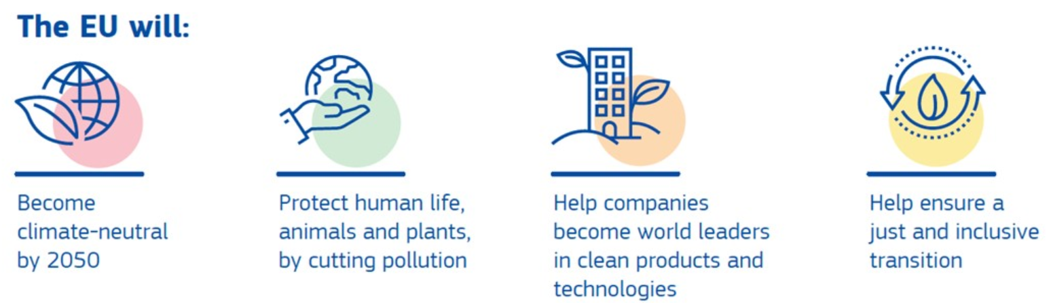
EU-Green Deal (2019)
Image: European Commission
Notes:
The European Green Deal was launched in 2019 and represents a set of policy measures adopted by the EU to enable the transition to a climate-neutral society by 2050. The objective of the Green Deal is to create a fair and prosperous society, supported by a modern and competitive economy.
To achieve this objective, the Green Deal emphasizes the need for a holistic and cross-sectoral approach in which all relevant policy areas are aligned with the overarching goal of climate protection. The package includes measures covering a wide range of policy fields, including climate, environment, energy, transport, industry, agriculture, and sustainable finance.
The European Green Deal aims to achieve a climate-neutral EU by 2050, with greenhouse gas emissions to be reduced by at least 55% by 2030 compared to 1990 levels. This requires a fundamental transformation of the economy and society across many sectors.
“Fit for 55” is a package of measures that includes the revision and updating of EU legislation as well as the introduction of new initiatives to ensure that EU actions are aligned with the climate targets set by the Council and the European Parliament.
Sources:
European Commission, Directorate-General for Communication (2019): What is the European Green Deal? Available at: https://data.europa.eu/doi/10.2775/944554 ; accessed 13 March 2025
Council of the European Union (2024): https://www.consilium.europa.eu/en/policies/green-deal/; accessed 13 March 2025
Image sources:
European Commission, Directorate-General for Communication (2019): What is the European Green Deal? Available at: https://data.europa.eu/doi/10.2775/944554 ; accessed 13 March 2025

Slide 25
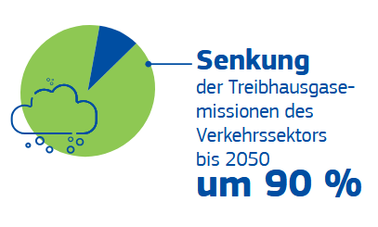
EU Green Deal – Transport Focus I
Reduction of greenhouse gas emissions in the transport sector by 90% by 2050
Digitalisation
Use of different modes of transport
Pricing that reflects environmental impacts (external costs)
Improvement of supply with sustainable alternative fuels
Reduction of air pollution
Image: European Commission
Notes:
Source:
European Commission (2019): https://ec.europa.eu/commission/presscorner/api/files/attachment/859448/Sustainable_mobility_de.pdf
Image source:
European Commission (2019): https://ec.europa.eu/commission/presscorner/api/files/attachment/859448/Sustainable_mobility_de.pdf

Slide 26


EU Green Deal – Freight Transport Targets
Rail freight transport: to increase by 50% by 2030 and to double by 2050
Inland waterway transport: to increase by 25% by 2030 and by 50% by 2050
Road
Rail
Inland waterways
Own illustration based on Eurostat
Notes:
Modal split describes the share of transport performance by mode of transport.
Target set within the framework of the Sustainable and Smart Mobility Strategy: rail freight transport is to increase by 50% by 2030 and to double by 2050. Inland waterway transport is to increase by 25% by 2030 and by 50% by 2050.
Sources:
Eurostat (2024): Modal split of inland freight transport:
https://ec.europa.eu/eurostat/databrowser/view/tran_hv_frmod/default/table?lang=en&category=tran.tran_hv_ms; accessed 6 February 2025
European Commission (2020): Sustainable and Smart Mobility Strategy:
https://eur-lex.europa.eu/resource.html?uri=cellar:5e601657-3b06-11eb-b27b-01aa75ed71a1.0003.02/DOC_1&format=PDF

Slide 27
Common Transport Policy
Focus on Trans-European Transport Networks (TEN-T network):
Development of an effective, EU-wide, and multimodal transport network
Includes railway lines, inland waterways, short sea shipping routes, and roads connected to cities, ports, airports, and terminals
Objective: sustainable and efficient transport corridors across the entire EU without bottlenecks or missing links
Milestones:2030 - completion of the core network; 2040 - completion of the extended core network; 2050 - completion of the comprehensive network
Notes:
The EU has introduced a policy for the Trans-European Transport Network (TEN-T) to develop an effective and multimodal transport network across the entire EU.
This network includes railway lines, inland waterways, short sea shipping routes, and roads connected to key transport hubs. The TEN-T policy identifies transport infrastructure within the Member States that provides high European added value and should form part of the TEN-T network. Such infrastructure must meet specific requirements, for example in terms of safety, quality, and environmental objectives.
This policy is of great importance for the development of a coherent and high-quality transport infrastructure in the EU. Its aim is to support sustainable and efficient transport routes, facilitate access to jobs and services, and promote trade and economic growth. The TEN-T policy also strengthens cohesion within the EU by fostering seamless cross-border connectivity of transport systems and eliminating bottlenecks.
The milestones for the Trans-European Transport Network are as follows: by 2030, completion of the core network (completion of the main transport routes); by 2040, completion of the extended core network (meeting requirements for speed and quality); and by 2050, completion of the comprehensive network (full functionality). The core network and the extended core network form the European transport corridors, representing the most strategic part of the network with the highest EU added value.
Source:
European Commission (2021): https://ec.europa.eu/commission/presscorner/detail/de/qanda_21_6725; accessed 12 April 2024

Slide 28
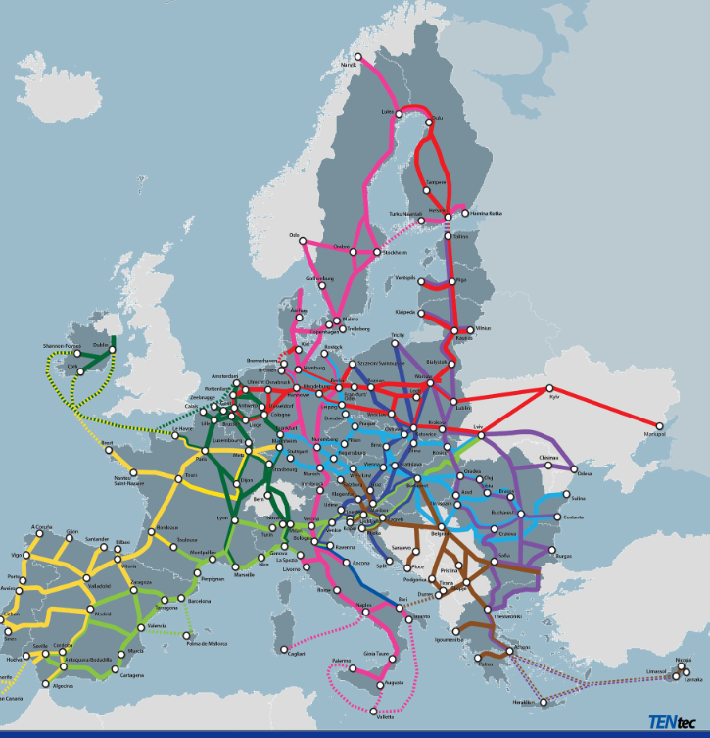
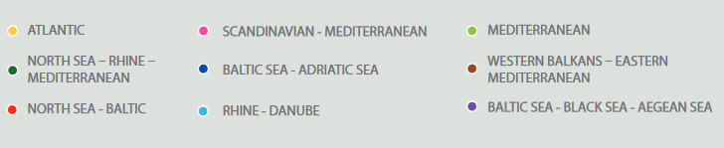
TEN-T Core Corridors
Image: European Commission
Notes:
The Trans-European Transport Network defines nine core corridors:
Scandinavian–Mediterranean Corridor
North Sea–Baltic Corridor
Atlantic Corridor
Rhine–Danube Corridor
Mediterranean Corridor
Baltic–Adriatic Corridor
Western Balkans–Eastern Mediterranean Corridor
North Sea–Rhine–Mediterranean Corridor
Baltic Sea–Black Sea–Aegean Sea Corridor
Image source:
European Commission (2024): TEN-T Maps. Licensed under CC BY 4.0. Available at:
https://transport.ec.europa.eu/transport-themes/infrastructure-and-investment/trans-european-transport-network-ten-t/tentec-information-system-and-ten-t-map-library/ten-t-maps-european-transport-corridors_en; accessed 18 November 2024.

Slide 29
Austrian Transport and
Climate Policy

Slide 30
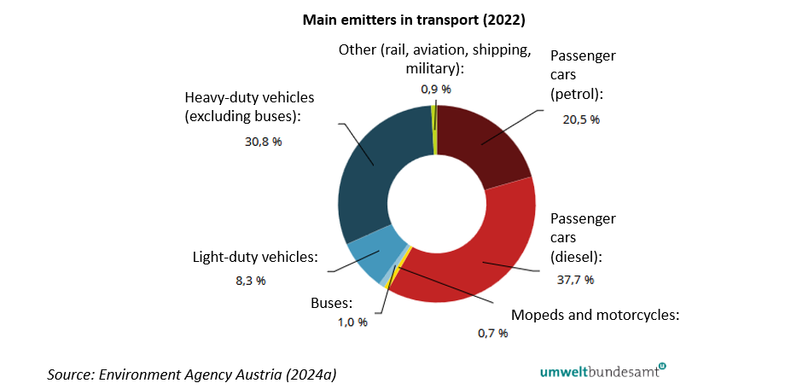
Transport Emissions in Austria
Notes:
Road transport accounts for approximately 99% of emissions in the transport sector (cf. Environment Agency Austria 2024, p. 138).
Source:
Environment Agency Austria (2024): Climate Protection Report 2024. Available at:
https://www.umweltbundesamt.at/fileadmin/site/publikationen/rep0913.pdf; accessed 14 January 2025

Slide 31
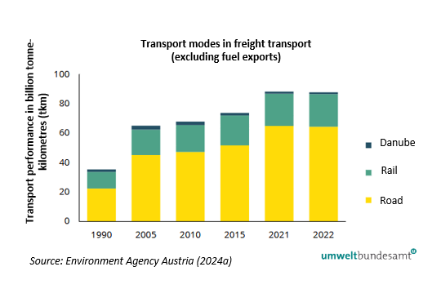
Development of the Modal Split in Austria
Strong increase in road freight transport
Slight decline in rail transport
Declining share of inland waterway transport
Notes:
Over time, Austria has experienced a strong increase in freight transport performance on roads, a slight decline in the rail share of the modal split measured in tonne-kilometres, and a decrease in the share of national freight transport on the Danube.
Source:
Environment Agency Austria (2024): Climate Protection Report 2024. Available at:
https://www.umweltbundesamt.at/fileadmin/site/publikationen/rep0913.pdf; accessed 14 January 2025, p. 156

Slide 32
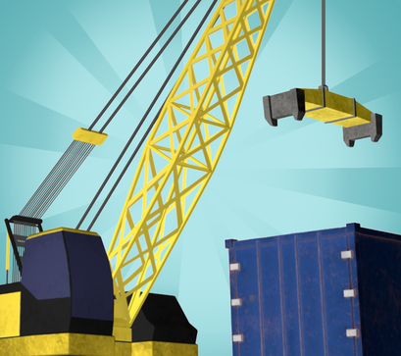
Activity: Transport Planning with the Logistify App
Game Means of Transport
Game Transport Chains
Green Transport
Your transport planning talent is needed – we need your help!
We want to transport various goods from A to B in the best possible way. The transport should be planned to be as ecological and economically efficient as possible.
Download the app at:
Logistify – Apps bei Google Play
Explanation video: https://www.youtube.com/watch?v=kZhL5SPtn6A
Image: FH OÖ
Notes:
Download the app at: https://play.google.com/store/apps/details?id=com.PieLab.Logistify
Explanation video: https://www.youtube.com/watch?v=kZhL5SPtn6A
More information at: https://www.rewway.at/de/logistify/
The learning app "Logistify" focuses on various means of transport, their sustainable and efficient use of resources, and logistics-related careers. In the games, students are challenged to use their transport planning skills. The task is to transport various goods efficiently from A to B, to plan multimodal transport chains from raw materials to end customers, and to explore careers in the logistics sector.
Duration: Game 1 takes approximately 15 minutes.
Learning objectives:
Students recognize the importance of different modes of transport in freight logistics.
Students reflect on how resources can be used sustainably and efficiently in transportation.
Students analyze logistical challenges and make well-reasoned decisions in transport planning.
Students playfully engage with digital learning formats to understand logistics concepts.

Slide 33
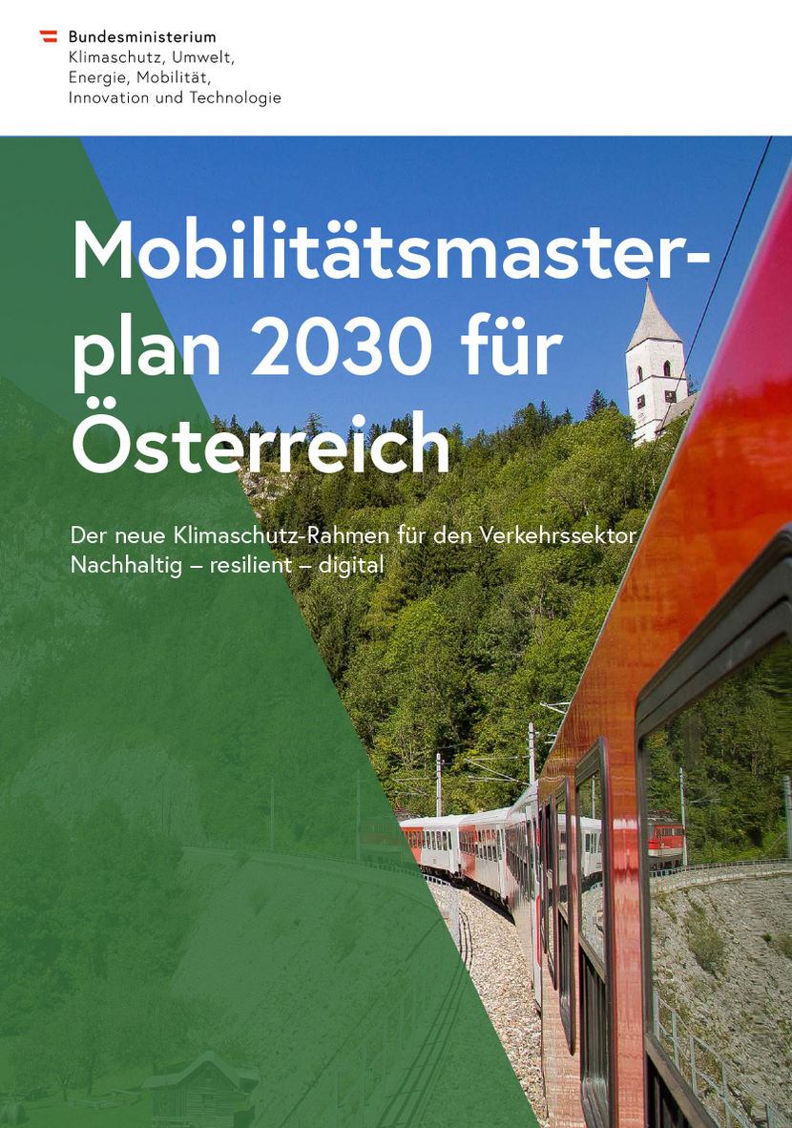
Mobility Master Plan 2030
Objective: Climate neutrality of the transport sector by 2040
Traffic avoidance
Traffic shift (modal shift)
Efficiency improvements
Notes:
The objective is to achieve climate neutrality in the transport sector by 2040. The Mobility Master Plan 2030 is based on a backcasting approach that assumes a mix of traffic avoidance, traffic shift (modal shift), and efficiency improvements.
Source:
Mobility Master Plan 2030: https://www.bmimi.gv.at/themen/mobilitaet/mobilitaetsmasterplan/mmp2030.html; accessed 16 December 2025
Image source:
Mobility Master Plan 2030: https://www.bmimi.gv.at/themen/mobilitaet/mobilitaetsmasterplan/mmp2030.html; accessed 16 December 2025

Slide 34
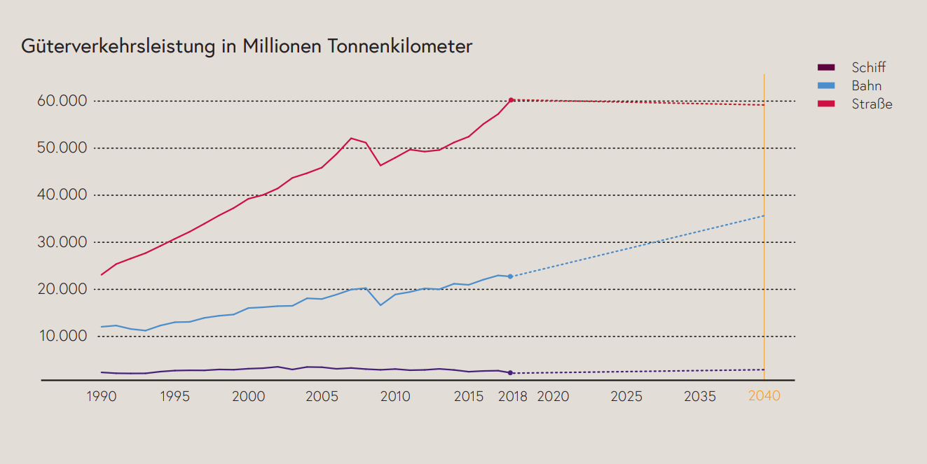
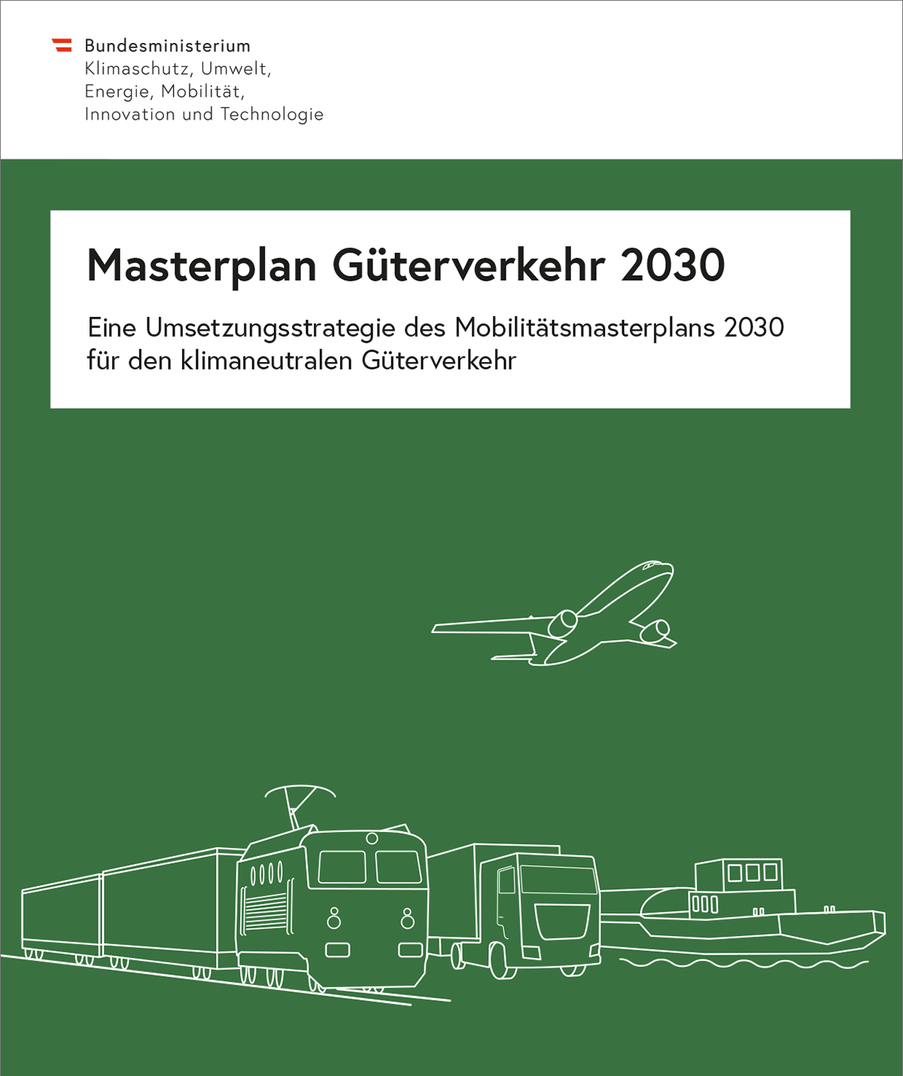
Freight Transport Master Plan
Planned Change in Modal Split
Overarching objective: Decoupling economic growth from the development of freight transport
Freight transport performance in million tonne-kilometres
Ship
Rail
Road
Graphic: Mobility Master Plan 2030
Grafik: Mobilitätsmasterplan 2030
Notes:
An explicit objective is to ensure that this increase is largely handled by the rail transport mode.
Source:
Freight Transport Master Plan 2030 (2023): An implementation strategy of the Mobility Master Plan 2030 for climate-neutral freight transport, available at: https://www.bmimi.gv.at/themen/mobilitaet/transport/gueterverkehr/masterplan.html, accessed: 16.12.2025
Graphic:
Mobility Master Plan 2030, available at: https://www.bmimi.gv.at/themen/mobilitaet/mobilitaetsmasterplan/mmp2030.html, accessed: 16.12.2025, p. 13
Image:
Freight Transport Master Plan 2030 (2023): An implementation strategy of the Mobility Master Plan 2030 for climate-neutral freight transport, available at: https://www.bmimi.gv.at/themen/mobilitaet/transport/gueterverkehr/masterplan.html, accessed: 16.12.2025

Slide 35
Freight Transport Master Plan
Planned Change in Modal Split
Focus on transport management:
Emphasis on traffic avoidance, modal shift, and efficiency improvement
Integration of a holistic approach
Integrated approach to efficient transport:
Optimisation of interconnections between different transport modes
Solid baseline in an EU comparison:
Comparison with other EU countries demonstrates a well-founded basis
This baseline sets a clear strategic direction for the development of freight transport
Concrete measures for achieving the objectives:
Comprehensive measures to reach the defined targets
To be viewed critically, but suitable as a foundation for change within the sector
Notes:
Source:
Masterplan Freight Transport 2030 (2023): An implementation strategy of the Mobility Master Plan 2030 for climate-neutral freight transport, available at: https://www.bmimi.gv.at/themen/mobilitaet/transport/gueterverkehr/masterplan.html, accessed: 16 December 2025

Slide 36
Critical Discussion of Policy Objectives (Kummer, 2024)
A study by Kummer identifies potential rail capacity bottlenecks by 2030 due to growing demand for both freight and passenger transport.
Rail transport requires capacity expansions, as well as innovative concepts to efficiently absorb future growth.
Efficiency-enhancing measures and improved utilization of existing capacities are necessary.
Integrated approach: Rail, inland waterways, and road transport must be addressed equally, with sustainable technologies and infrastructure serving as key enablers for achieving climate targets.
Notes:
Source:
Kummer / Geske (2024): Centre for Transport Economics: Study on Decarbonisation and Modal Split in Freight Transport and Logistics, available at: https://www.spediteure-logistik.at/fileadmin/user_upload/Update_ZV-Studie_PK_24_06_04.pdf, accessed: 16 December 2025

Slide 37
Information for Teachers
This slide deck is available under the Creative Commons Attribution 4.0 International License (CC BY 4.0).
You may therefore freely integrate these teaching materials into your classes, adapt them to your needs, and share them with pupils, students, or other audiences.
We kindly ask that the logos displayed on the slides remain unchanged.
Image rights are specified in the notes section; use in other contexts is not permitted.
Statement on the Use of Generative AI and AI-Assisted Technologies:
During the development of this project, the authors used ChatGPT and Microsoft Copilot to support conceptual development and wording. The use of these AI tools was carried out following careful consideration. Subsequently, all content was critically reviewed by the authors and revised where necessary to ensure compliance with scientific standards. The authors assume full responsibility for the final content and its publication.

Slide 38


The project receives funding under the Horizon Europe Call “Safe, Resilient Transport and Smart Mobility services for passengers and goods”; Call ID: HORIZON-CL5-2021-D6-01, Grant ID: 101069796
https://multireload.eu/

Slide 39
Literature I
Austrian Environment Agency (2024): Climate Protection Report 2024.https://www.umweltbundesamt.at/fileadmin/site/publikationen/rep0913.pdf; accessed 16.12.2025
Christidis, P., & Brons, M. (2016): External costs of freight transport in European Union Member States (Joint Research Centre (JRC)). Harvard Dataverse.https://dataverse.harvard.edu/dataset.xhtml?persistentId=doi:10.7910/DVN/YA3VCY; accessed 28.01.2025
European Commission(2019): https://ec.europa.eu/commission/presscorner/api/files/attachment/859448/Sustainable_mobility_de.pdf
European Commission (2020): Strategy for Sustainable and Smart Mobility.https://eur-lex.europa.eu/resource.html?uri=cellar:5e601657-3b06-11eb-b27b-01aa75ed71a1.0003.02/DOC_1&format=PDF
European Commission (2021):https://ec.europa.eu/commission/presscorner/detail/en/qanda_21_6725; accessed 12.04.2024
European Commission, Directorate-General for Communication (2019): What is the European Green Deal?https://data.europa.eu/doi/10.2775/944554; accessed 13.03.2025
European Council of the European Union (2024):https://www.consilium.europa.eu/en/policies/green-deal/; accessed 13.03.2025

Slide 40
Literature II
Eurostat (2024): Modal split of inland freight transport.https://ec.europa.eu/eurostat/databrowser/view/tran_hv_frmod/default/table?lang=en&category=tran.tran_hv_ms; accessed 06.02.2025
Eurostat (2025): https://ec.europa.eu/eurostat/statistics-explained/index.php?title=Characteristics_of_the_railway_network_in_Europe; accessed 06.03.2025
ITF (2023): ITF Transport Outlook 2023. OECD Publishing, Paris; https://doi.org/10.1787/b6cc9ad5-en; accessed 16.12.2025
Koch, Susanne (2012): Logistics – An Introduction to Economics and Sustainability
Kummer, Sebastian (2010): Introduction to Transport Economics. 2 volumes. Vienna: UTB, Facultas, WUV
Masterplan Freight Transport 2030 (2023): An Implementation Strategy of the Mobility Master Plan 2030 for Climate-Neutral Freight Transport. https://www.bmimi.gv.at/themen/mobilitaet/transport/gueterverkehr/masterplan.html; accessed 16.12.2025
Mobility Master Plan 2030: https://www.bmimi.gv.at/themen/mobilitaet/mobilitaetsmasterplan/mmp2030.html; accessed 16.12.2025
Schienen-Control (2025): https://www.schienencontrol.gv.at/de/wettbewerbsregulierung/eisenbahnnetz-oesterreich.html; accessed 28.01.2025
Wittenbrink, Paul (2015): Green Logistics. Wiesbaden: Springer Fachmedien Wiesbaden.

