Slide 1
How to work with this learning material
Power Point
The following power point presents ports and inland vessels. The slides are shortly described in the notes below and you can also find the link to the source if you need further information.
Reader
In addition to the power point presentation, you can also use the reader provided on our platform. It’s more detailed and could be used as a script.
Links
You can also find the sources of our presentation and reader in the links section of the relevant bundled teaching material.
Videos and exercises
There are also different videos and exercises used as sources in this presentation. You can find these videos as well as a variety of exercises separately in the relevant bundled teaching material.

Slide 2
Learning objectives
After working through this content, the learners know…
the main structure of a port, the key functions, as well as the value-added-services offered by ports.
Facts and figures about the Austrian ports and the most important ports of the Rhine-Main-Danube-Corridor.
the different tasks in a port, types of transhipment and equipment for transhipment of goods in a port and their performance.
the types of vessels on the Danube and their fields of application, as well as the trends on Danube navigation.
Target group
Secondary school students
Vocational school students
University students as introduction in inland navigation

Slide 3
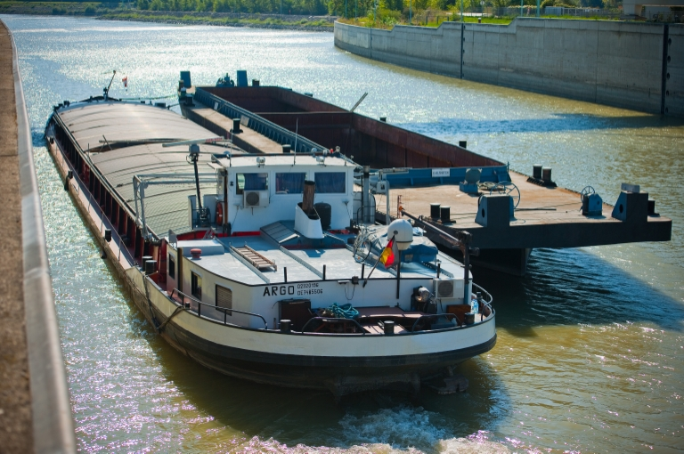
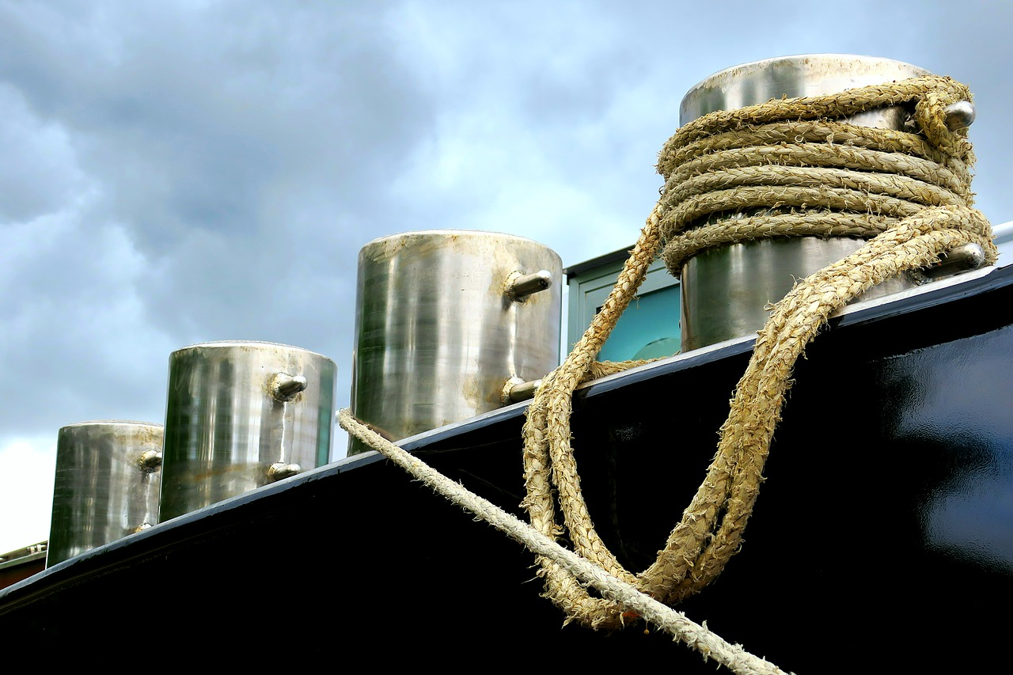

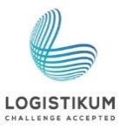

PORTS and INLAND VESSELS
Quelle: via donau
Quelle: pixabay
Notes:
This set of slides provides you with information on the tasks and functions of (Danube) ports and gives an overview of existing transhipment equipment.

Slide 4
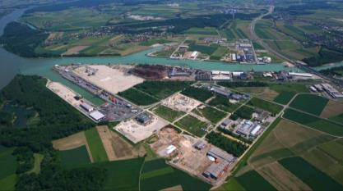
Warm-Up
Ports and Inland Vessels
source: via donau, Ennshafen
Which Austrian ports are on the Danube?
Which activities do ports fulfill?
Notes:
The questions mentioned in the slide above can be used as a warm up exercise for the topic “ports and inland vessels”. The aim is to discuss the questions in plenum with students. Answers to the questions will be provided during the presentation. Therefore, the questions can be discussed again at the end of the presentation.
Discussion questions (5-10 minute Discussion):
What Austrian ports are on the Danube? Linz, Vienna, Enns, Krems (public ports)
Ports fulfill what activities? Transhipment, storage, packing, stuffing and stripping of containers, commissioning, distribution, project logistics
Input- possible topics of discussion:
Ports as logistics providers
Structure of a Port
Capacity
Types of drive
(A detailed overview can be found in the manual on Danube navigation on page 86 et seqq., 112)
Picture: viadonau, Ennshafen, manual of Danube Navigation page 103

Slide 5
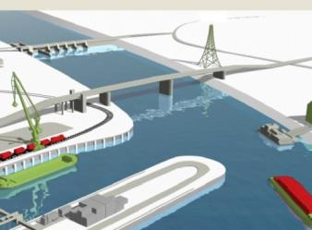
System Elements of Danube Navigation
legal and policy framework
the Danube
waterway
inland vessels
ports and terminals
River Information Services
www.ines-danube.info
as the basic environment for the
transport of goods
as means of transport for the different types of cargo
for the transhipment of goods
raise transport safety and improve the cost-effectiveness, reliability and predictability of inland waterway
ensures a national and international smooth flow of transport
source: via donau
Notes:
The system elements of Danube Navigation are the Danube waterway, the ports as hubs to connect with the transport modes road and rail, as well as the vessels and their cargo. The potential of inland navigation will only be fully utilisable if all elements within the system interact smoothly.
Source: Manual on Danube navigation on page 14-17.
Picture: www.ines-danube.info

Slide 6
Ports and Inland Vessels
Basic Structure of a Port
Transhipment/
Transhipment Modes
Types of Vessels
Danube Ports

Slide 7
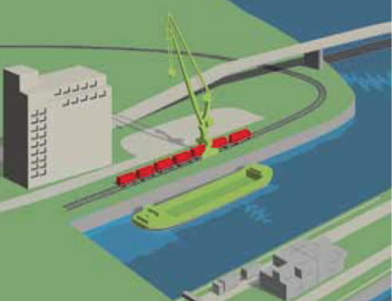
Definition
Basic Structure of a Port
Port
  facility for the transhipment of goods
  at least one port basin
  (otherwise transhipment site)
  connection to other modes of transport
picture: via donau
source: viadonau
Notes:
Ports are facilities for transhipment of goods that have at least one port basin.
A port has many advantages compared to a transhipment site: Firstly it has longer quay walls and can therefore offer more possibilities for transhipment and logistics. Certain cargo groups are only allowed to be transhipped in a port basin in accordance with national laws. Secondly ports provide an important protective function: During flood water, ice formation or other extreme weather events ships can stay safe in the port.
Manual on Danube Navigation page 86-108.
Picture: viadonau, Manual of Danube Navigation p 86
Transhipment = shifting of transport units or goods from one means of transport to another (Glossary, Manual of Danube Navigation p 224)

Slide 8
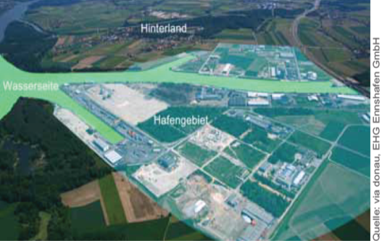
The three main areas of a port
Basic structure of a port
water-side area:
  port basin
  quay walls
port area:
  cranes
  transhipment places
  etc.
hinterland:
  catchment area of the port
source: viadonau
Notes:
Every port is structured into three main areas:
The water side area of a port is formed by a port basin and quay walls.
The handling area directly behind the quay walls is part of the port area. Cranes, crane tracks and quay tracks are located in this area. Besides areas used for industrial settlements, the port area also consists of areas for logistics service providers.
The hinterland is the catchment area of the port. A port concentrates and distributes traffic flows from the hinterland.
Manual on Danube Navigation page 87-88.
Picture: viadonau, Ennshafen, Manual of Danube Navigation p 88

Slide 9
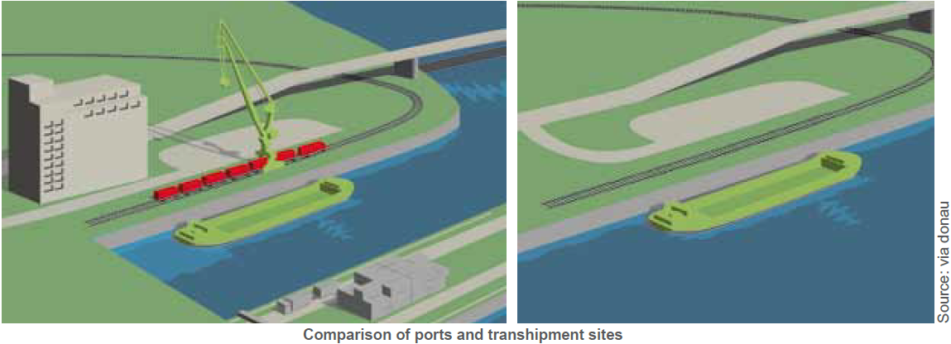
Transhipment sites
Basic structure of a port
transhipment points without a port basin
shorter quay walls than a port
not all cargoes are allowed by national laws
one or more terminals
source: viadonau
Notes:
Transhipment points without a port basin are known as transhipment sites.
A port has many advantages compared to a transhipment site: Firstly it has longer quay walls and can therefore offer more possibilities for transhipment and logistics. Certain cargo groups are only allowed to be transhipped in a port basin in accordance with national laws. Secondly ports provide an important protective function: During flood water, ice formation or other extreme weather events ships can stay safe in the port.
Manual on Danube Navigation page 86.
Picture: viadonau, Manual of Danube Navigation p 86

Slide 10
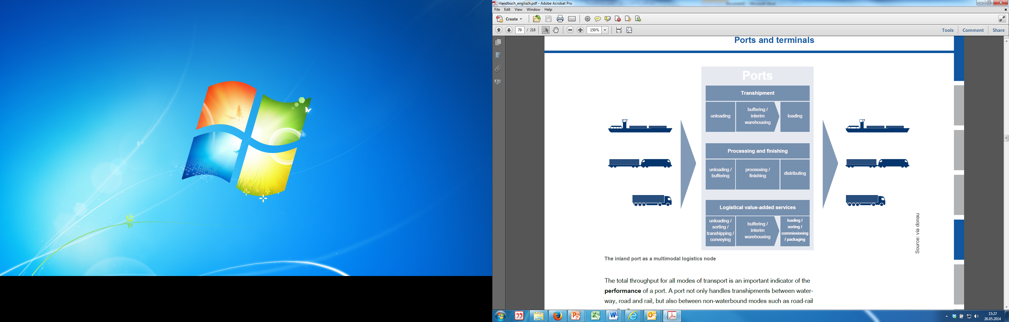
Ports as Logistics Service Provider
Basic structure of a port
picture: viadonau
Notes:
Ports connect the transport modes of road, rail and waterway and are important service providers in the fields of transhipment, storage and logistics.
In addition to their basic functions of transhipment and storage of goods, the also often perform a variety of value-added logistics services to customers, such as packaging, container stuffing and stripping, sanitation and quality checks. This enhances ports as logistics platforms and impetus sources for locating companies and boosting the economy. As multimodal logistical hubs, they act like nodal points between various transport modes.
Manual on Danube Navigation page 86-87.
Picture: viadonau, Manual of Danube Navigation p 87

Slide 11
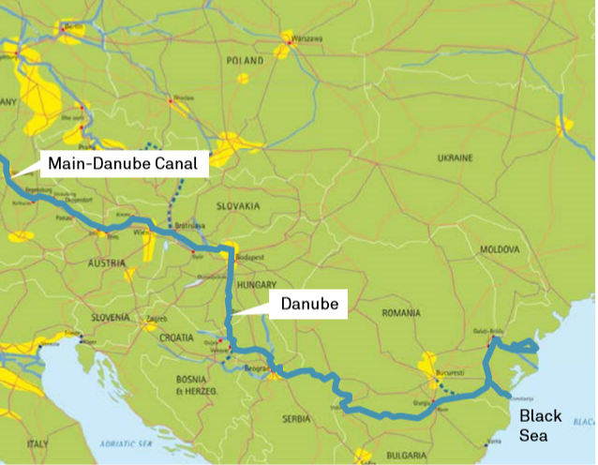
Ports as Logistics Service Provider
Basic structure of a port
connection between transport modes (road, rail, waterway)
service for transhipment, storage and logistic
value-added logistics services:
  packing
  container stuffing and stripping
  (load and unload)
  quality checks
  Sanitation
three major ports on the Danube:
  Izmail (Ukraine)
  Linz (Austria)
  Galati (Romania)
Picture: viadonau, Inland Navigation Europe
source: via donau
Notes:
Ports connect the transport modes of road, rail and waterway and are important service providers in the fields of transhipment, storage and logistics.
In addition to their basic functions of transhipment and storage of goods, the also often perform a variety of value-added logistics services to customers, such as packaging, container stuffing and stripping, sanitation and quality checks. This enhances ports as logistics platforms and impetus sources for locating companies and boosting the economy. As multimodal logistical hubs, they act like nodal points between various transport modes.
Manual on Danube Navigation page 86-87.
Picture: viadonau, Inland Navigation Europe, Manual on Danube Navigation p 44

Slide 12
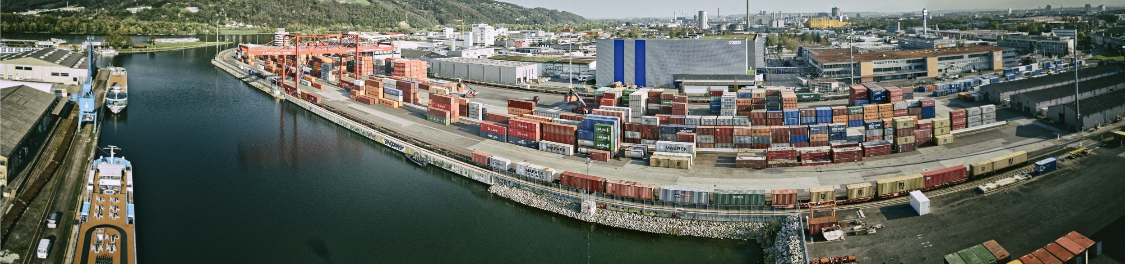
Quiz
Basic structure of a port
What do ports have, that differs them from transhipment sites?
Several terminals
Port basin
A shorter quay wall
A train connection
Quelle: via donau
Notes:
What do ports have, that differs them from transhipment sites?
At least one port basin
Picture: https://fotos.viadonau.org

Slide 13
Ports and Inland Vessels
Basic Structure of a Port
Transhipment/
Transhipment Modes
Types of Vessels
Danube Ports

Slide 14
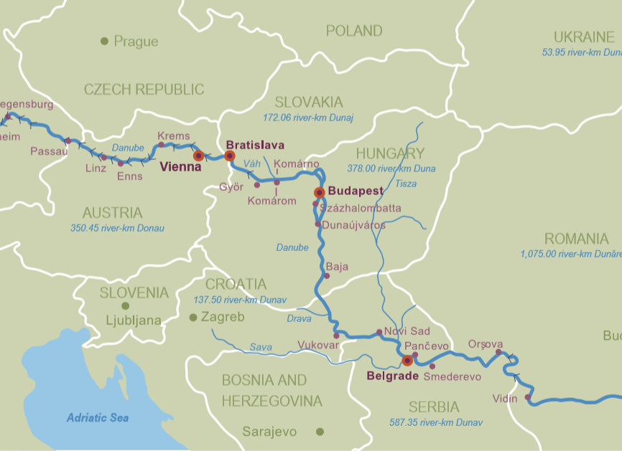
Overview of all Austrian Danube Ports
Danube Ports
picture: viadonau
Notes:
The four public ports in Austria are following:
Linz
Enns
Krems
Wien
The biggest port in Austria, regarding waterside transhipment is the private port of voestalpine in Linz.
Manual on Danube Navigation p. 86 et. seqq
Picture: Manual on Danube Navigation p 46

Slide 15
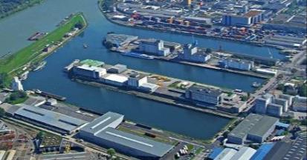
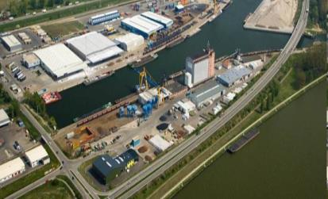
Austrian Danube Ports
Danube Ports
picture: Linz AG
Port of Linz
  trading- and refuelling port & voestalpine
  total transhipment of
  3.2 mio. tons of goods (2018)
Ennshafen
  > 350 ha area
  2.300 employees in all companies
Port of Krems
  total quay wall 1.560 m
picture: Ennshafen
picture: Mierka Donauhafen Krems
source: via donau
Notes:
Linz is the biggest port of the Upper Danube. A total amount of 3.6 millions tons of cargo was transhipped in the public port and the voestalpine port in Linz in 2017.
In the public port a variety of goods are transhipped, in the tanker port mineral oil products are transhipped, stored and distributed. Modern equipment is available at the 150 ha area (approx.. 45 ha water) for efficient transport and safe storage of the products.
The Ennshafen is located on the border between Upper and Lower Austria on the Upper Danube. More than 50 companies with approx. 2000 employees are located there.
The port of Krems is located approximately in the middle of the 3.500 km long Rhine-Main-Danube waterway and has a 1.560 m long quay wall.
Annual report on Danube Navigation, viadonau 2018 page 30 et seqq.; https://www.ennshafen.at/infrastruktur/
Picture: Manual on Danube Navigation 2013 p 93

Slide 16
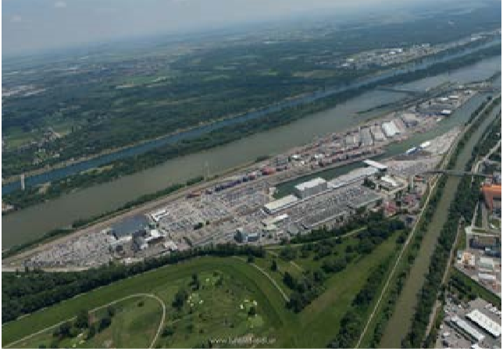
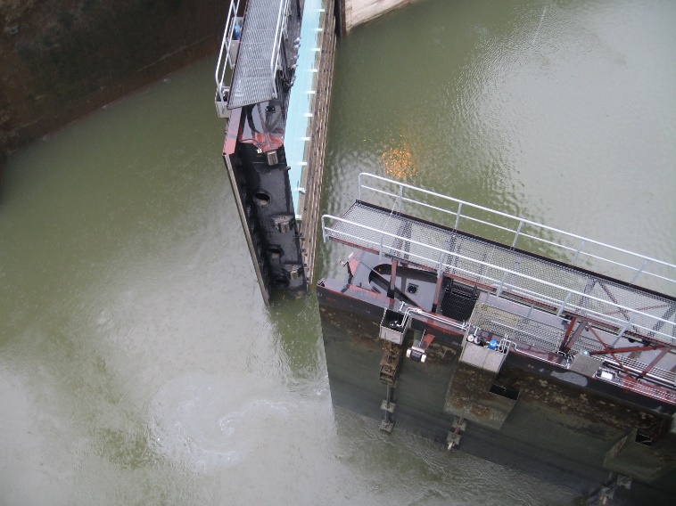
Austrian Danube Ports
Danube Ports
picture: Hafen Wien
Port of Vienna
Oil Port Lobau
    1.000 tanker per year
    1 Mio. tons/year of mineral oil products
Container Port Freudenau
    350.000 container/ 2018*
    60.000 new cars/ 2018*
Port of Albern
    for building material, steel products and
    agricultural products
*water and landside transhipment in total
Quelle: viadonau
source: Hafen Wien
Notes:
The whole area of the port in Vienna is approx.. 300ha large. Three big cargo ports are operated here: the port of Freudenau, the port of Albern and the port for oil products in Lobau. Annually in all three ports a total of 1.700 cargo vessels are being dispatched.
In the port of Lobau 1.000 tankers are dispatched and 1 million tons of mineral oil products transhipped annually.
At the container port of Freudenau, 300.000 containers and 700.000 cars are transhipped annually.
In the port of Albern construction materials, steel products and agricultural products are transhipped and stored.
Sources:
http://www.hafen-wien.com/de/home/unternehmen/standorte/31/Hafen-Albern [15.03.2020]
http://www.hafen-wien.com/de/home/unternehmen/standorte/35/Oelhafen-Lobau [15.03.2020]
http://www.hafen-wien.com/de/home/unternehmen/zahlen-daten [15.03.2020]
Picture: Hafen Wien, viadonau, Manual on Danube Navigation 2013 p 93
https://fotos.viadonau.org

Slide 17
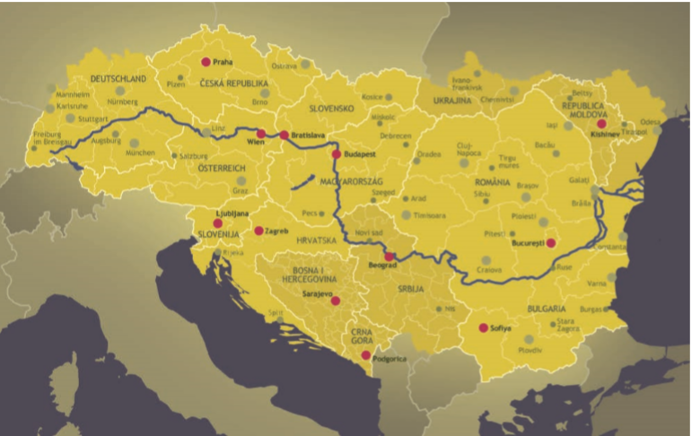
Danube Ports
Danube Ports
picture: INTERACT
about 80 ports along the Danube
40 international ports
(= E-ports)
collection of all Danube-Ports: http://www.danubeports.info/index.php
source: viadonau
Notes:
Along the Danube there are more than 80 ports, 40 of them are so called e-ports making them inland ports of international importance. The average distance between these Danube ports is around 60 km, but only approx. 20 km in the Rhine region.
Manual on Danube Navigation page 105.
Picture: INTERACT, Manual on Danube Navigation p 29

Slide 18
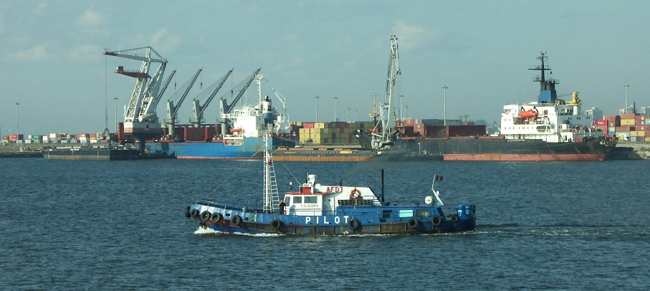
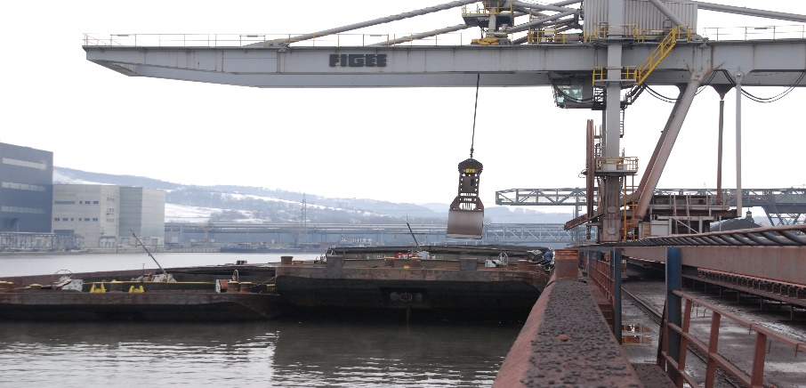
Ports – Rhine-Main-Danube-Corridor
Danube Ports
Duisport as biggest port* in the Rhine-Main-Danube-Corridor
  transhipment of about 65.3 Mio. tons of goods (2019)
  1.550 hectare, 21 docks, 37 km shoreline
port of Constanta (Romania) biggest* Danube port
  transhipmet of about 66.6 Mio. tons of goods (2019)
factory port of voestalpine as biggest* Austrian Danube port
  transhipment of about 3,6 Mio. tons of goods (2017)
*volume of water transhipment
Quelle: Port of Constanta, Via donau
Quelle: LogServ, Via donau
sources: Duisport, Port of Constanza, via donau
Notes:
The port of Duisburg (called Duisport) is the largest port in the Rhine-Main-Danube corridor. 2019 127.5 million tons were transhipped there. The whole area is of 1.350ha. It contains 21 port basins and 37km of shore length.
Regarding the waterside transhipment amount the Danube port of Constanta in Romania is the largest Danube port (66.6 million tons in 2019).
In Austria the private port of voestalpine in Linz is the largest port with 3.6 million tons of waterside transhipment in 2017.
sources:
Duisport: https://www.duisport.de/hafeninformation/)
Port of Constanta:
http://www.portofconstantza.com/apmc/portal/static.do?package_id=st_generale&x=load
Port of Linz (voestalpine):
https://www.wko.at/service/verkehr-betriebsstandort/Donauhaefen.html#heading_stadthafen_linz
Pictures: viadonau Port of Constanta, LogServ

Slide 19
Quiz
Danube ports
Which port is the biggest inland port in the Rhine-Main-Danube Corridor?
Port of Constanta
Port of Rotterdam
Duisport
Factory port of the voestalpine
Notes:
Which port is the biggest inland port in the Rhine-Main-Danube Corridor?
Duisport

Slide 20
Ports and Inland Vessels
Basic Structure of a Port
Transhipment/
Transhipment Modes
Types of Vessels
Danube Ports

Slide 21
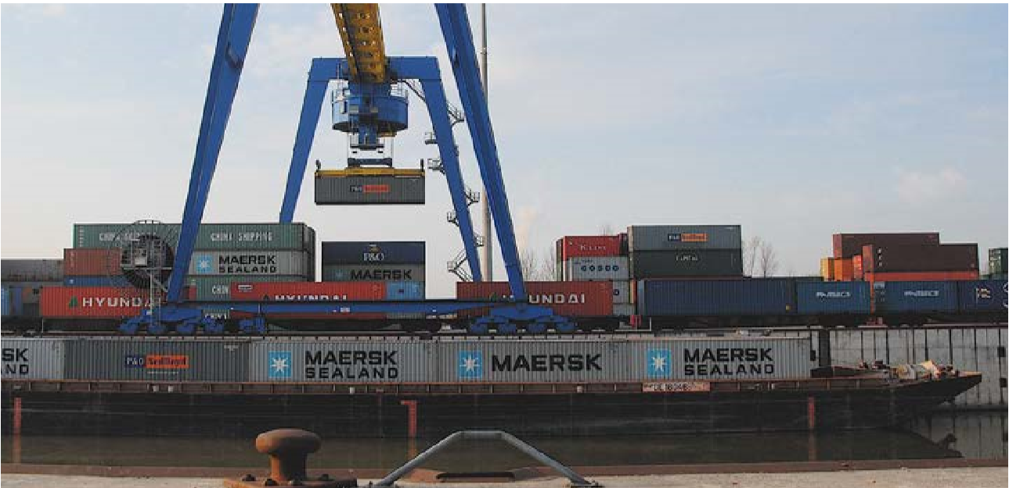
Definition
Transhipment/Transhipment Modes
Transhipment
shifting of goods from one mean of transport
to another
within a transport chain
e.g. loading of goods from truck
to inland vessel
picture: Ennshafen
source: via donau
Notes:
Transhipment means shifting of transport units or goods from one means of transport to another, for example from a lorry to an inland waterway vessel or from a vessel to a train. The transhipment process is often supported by cranes, reach stackers or other working equipment.
Manual on Danube Navigation page 86-108.
Picture: Ennshafen, Manual on Danube Navigation p 99

Slide 22
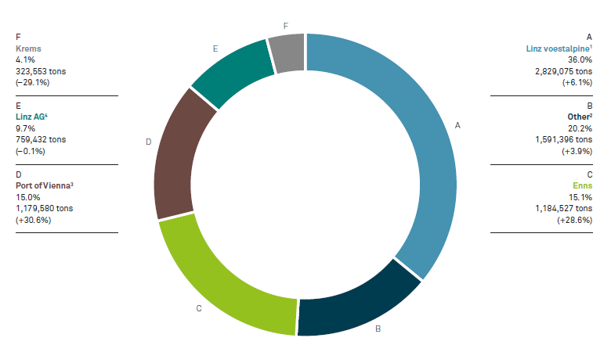
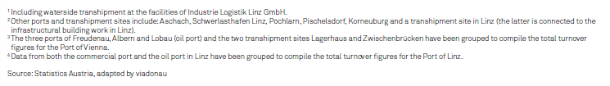
Distribution of Water Transhipment at Austrian Danube Ports 2021
Transhipment/Transhipment Modes
source: via donau
Sonstige
Notes:
Just under 8.3 million tons were transported on the Austrian Danube in 2021, similar to the previous year. This corresponds to a slight increase of 0.3% in transport volume. Compared to the previous year, the commodity group ranking also remained unchanged in terms of total transport volume.
Source:
Annual report on Danube Navigation, viadonau 2021, p. 20 f. :

Slide 23
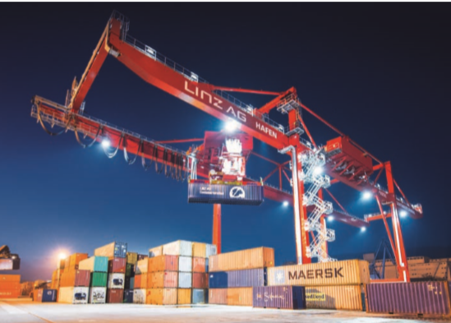
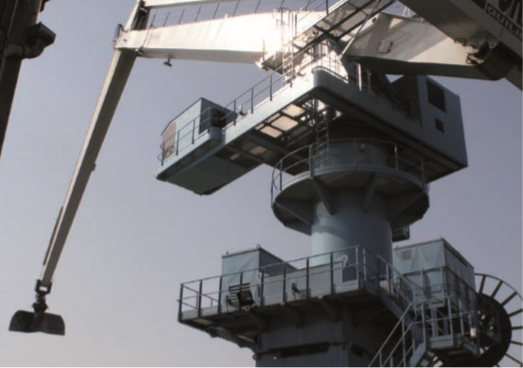
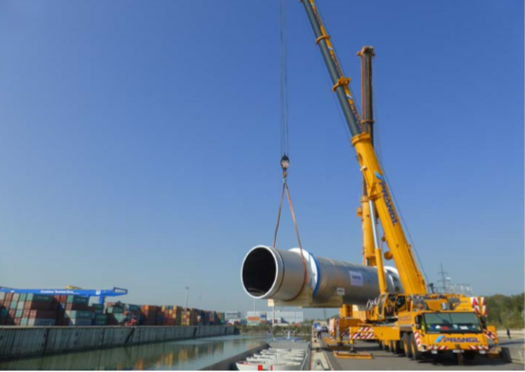
Types of Cranes
Transhipment/Transhipment Modes
picture:: Linz AG
picture: viadonau
picture: Ennshafen
bridge- or gantry crane
  container transhipment
  Ø 25 container/hour
luffing and slewing crane
  multi purpose
  transhipment crane
  for hook- and grabbing goods
mobile crane
  to support existing
  crane equipment
  often slower than
  special cranes
source: viadonau
Notes:
The installation and acquisition of different types of cranes depends on the types of goods handled.
Gantry or portal cranes are mainly used for the transhipment of containers, although they can also handle cargo such as sheet metal or pipes. The capacity is approx.. 25 containers per hour.
A luffing and slewing crane is a multipurpose transhipment crane and is suited for transhipment of goods using hooks and grabbers. Procurement costs are significantly less than those of a gantry crane.
Mobile cranes can be used as primary equipment at a port and can also provide support for existing crane equipment.
Manual on Danube Navigation page 90-92.
Picture: Linz AG, viadonau, Ennshafen, Manual on Danube Navigation p 90,91

Slide 24

Performance of Port
Transhipment Equipment
Transhipment/Transhipment Modes
The capability of a port depends on its transhipment equipment (lifting capacity and day- or hourly output of cranes)
 | luffing and slewing crane until 15t | luffing and slewing crane until 30t | gantry crane (bridge) until 40t
grab operation¹⁾ | 120t/h | 160t/h | 200t/h
hook operation | 80t/h | 100t/h | 120t/h
spreader |  | 15 Container/h | 25 Container/h
1) Up to 800 t/h at bulk goods for the steel industry (coal, ore, etc.)
source: INeS Danube, via donau
Notes:
The performance of port transhipment equipment is defined by the maximum lifting capacity as well as the hourly or daily output of each individual crane. Modern gantry cranes or mobile cranes can accommodate 30 tons with 20 meter outreach and thereby efficiently tranship full containers or heavy steel coils from vessel to quay or from truck to railway wagon.
Manual on Danube Navigation page 89.
Spreader: hoisting equipment of gantry cranes; a telescopic frame that can be adjusted to the length of a container; the studs of the spreader hold the corner fittings of the container and are locked; thereafter, the container may be lifted
(Glossary, Manual of Danube Navigation p 224)

Slide 25
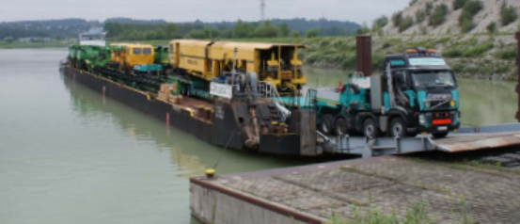
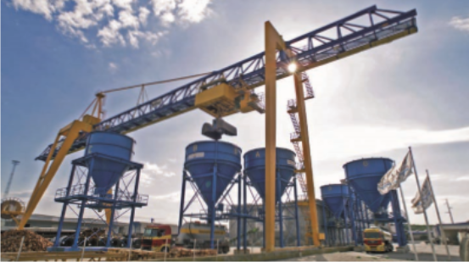
Other Transhipment Modes
Transhipment/Transhipment Modes
Ro-Ro-Ramp (Roll-on-Roll-off)
  transhipment of roll on/roll off units (e.g. cars)
  cars or trucks „roll“ directly on board of the ship
loading hoppers
  transhipment of bulk goods
  bulk goods (e.g. gravel, fertilizer) can be transhipped faster
  loading hoppers can also be
  used as a temporary storage facility
picture: Ennshafen
picture: Rhenus Donauhafen Krems
source: via donau
Notes:
The transhipment of rolling cargo such as cars requires the ports to have a roll-on-roll-off ramp. Numerous Danube ports are equipped with such a ramp.
Loading hoppers are used for the transhipment of bulk cargo from an inland vessel to a railway wagon or to a truck. Due to the fact that an inland vessel can carry far larger amounts than a truck trailer or a railway wagon, a loading hopper is needed to accommodate with different cycle times in the transhipment process. A crane loads the bulk cargo from the inland vessel from above into the hopper, while trucks or railway wagons located under the hopper are being filled at the same time. These loading hoppers can also be used as temporary storage facilities.
Manual on Danube Navigation page 92.
Picture: Ennshafen, Rhenus Donauhafen Krems, Manual on Danube Navigation p 92

Slide 26
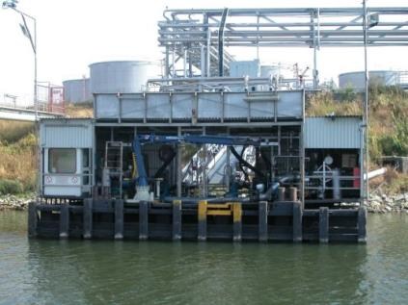
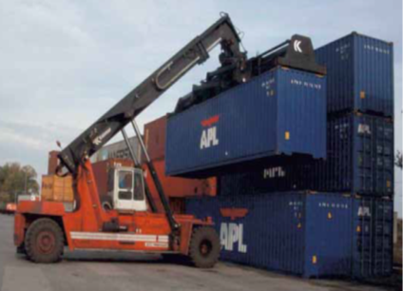
Other Transhipment Modes
Transhipment/Transhipment Modes
suction- and pumping equipment
  transhipment of liquid goods
reach stacker
  wheeled vehicles, to support cranes
  maximum working load 45 tons
picture: viadonau
Source: WienCont Containergesellschaft mbH
source: via donau
Notes:
Special suction and pumping equipment is needed for transhipping liquid goods. This equipment, so called fillers, are connected to the tanker vessel using a swinging arm and the cargo is pumped directly into the storage tanks or waiting railway wagon or trucks. Vice versa, tankers are filled from the warehouse. Since the majority of liquid goods are classified as dangerous goods, these transhipment facilities are subject to stringent safety standards.
Reach stackers are wheeled vehicles which can tranship containers using spreaders. These vehicles are predominantly used as a supplement to cranes or gantry cranes. Whereas a forklift can only hoist containers upwards in vertical direction, a reach stacker can also move containers forward by using an exandable lifting arm. This allow the vertical storage of containers in piles, which can reach a height of 4 to 6 containers.
Manual on Danube Navigation page 93-94.
Picture: viadonau, WienCont Containergesellschaft mbH, Manual on Danube Navigation 2013 page 83-84

Slide 27
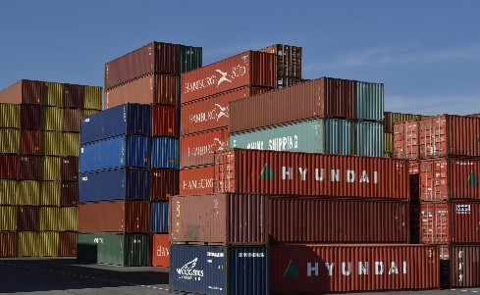


Quiz
Transhipment/Transhipment Modes
What is the definition of the term „transhipment“?
vehicles that serve to goods and passengers such as trucks, trains or inland vessels
shifting of goods from one mean of transport to another within a transport chain
transport infrastructure
partial route at the beginning of the transport chain
Pixabay.com
Notes:
What is the definition of the term „transhipment“?
Shifting goods from one mean of transport to another within a transport chain
Pictures: Pixabay.com

Slide 28
Ports and Inland Vessels
Basic Structure of a Port
Transhipment/
Transhipment Modes
Types of Vessels
Danube Ports

Slide 29
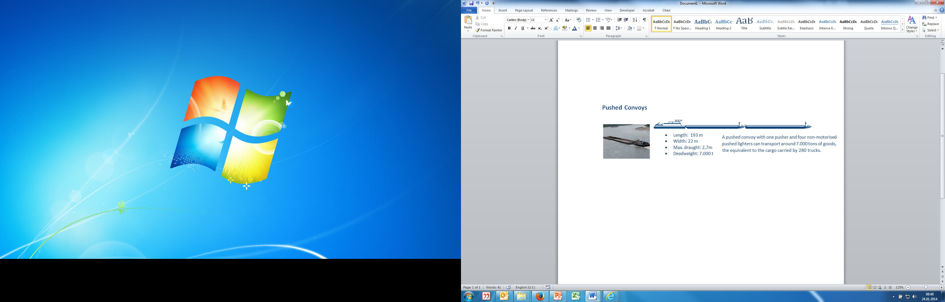
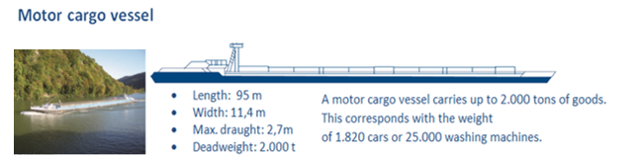
Cargo Vessels
Types of Vessels
source: viadonau
source: viadonau
Notes:
On inland waterway, inland waterway vessels are used for transport of goods. There are basically three types:
Motor cargo vessels (or self-propelled vessels) are equipped with a motor drive and cargo hold.
Pushed convoys usually consists of a pusher and one or more non-motorized pushed lighters or pushed barges. They are firmly attached to the pushing unit, and at least one unit is positioned in front of the pushing craft. A coupled formation or side-by-side formation consists of one motor cargo vessel with one or two lighters or barges coupled on its sides.
Tugs are used to tow non- motorized vessel units, so called barge. Towed convoys are rarely used on the Danube any more because they are less cost-effective than pushed convoys.
Manual on Danube Navigation page 112-118.
Picture: viadonau, Manual on Danube Navigation Page 112, 158

Slide 30
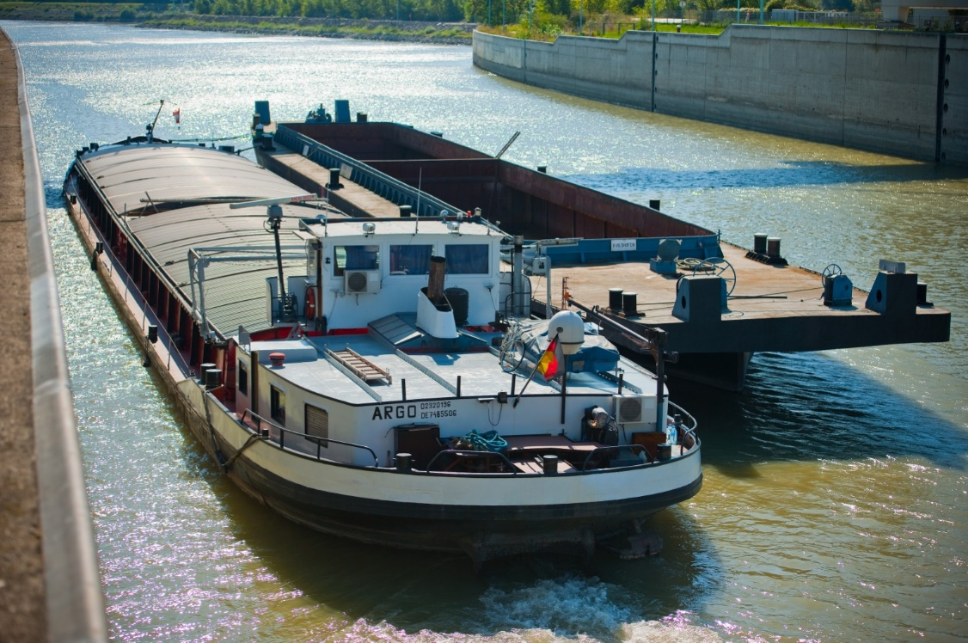
Motor Cargo Vessels
Types of Vessels
self-propelled vessels
equipped with motor drive
and cargo hold
picture: viadonau
source: viadonau
Notes:
Motor cargo vessels (or self-propelled vessels) are equipped with a motor drive and cargo hold.
Source: Manual on Danube Navigation page 112.
Picture: viadonau, https://fotos.viadonau.org

Slide 31
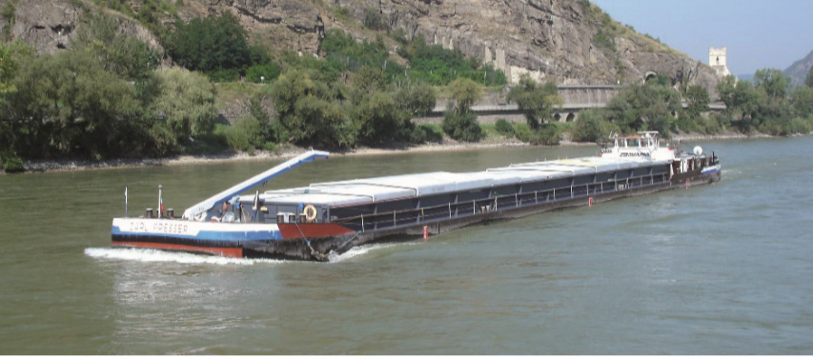
Example: motor cargo vessel
Types of vessels
Source: viadonau
Europaschiff:
Length 85 m - Width 9,5 m max. draught 2,5 m – max deadweight 1.350 t
Corresponding of a load carried by 54 lorries.
Quelle: Jaegers
Notes:
Source: Manual on Danube Navigation p. 115-116
Picture: viadonau, Manual on Danube Navigation p. 116

Slide 32
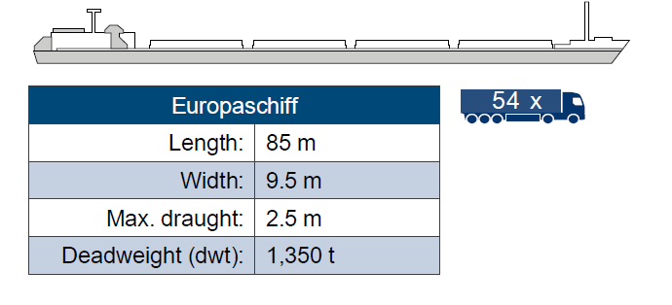
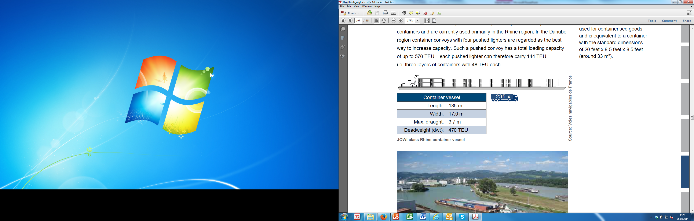
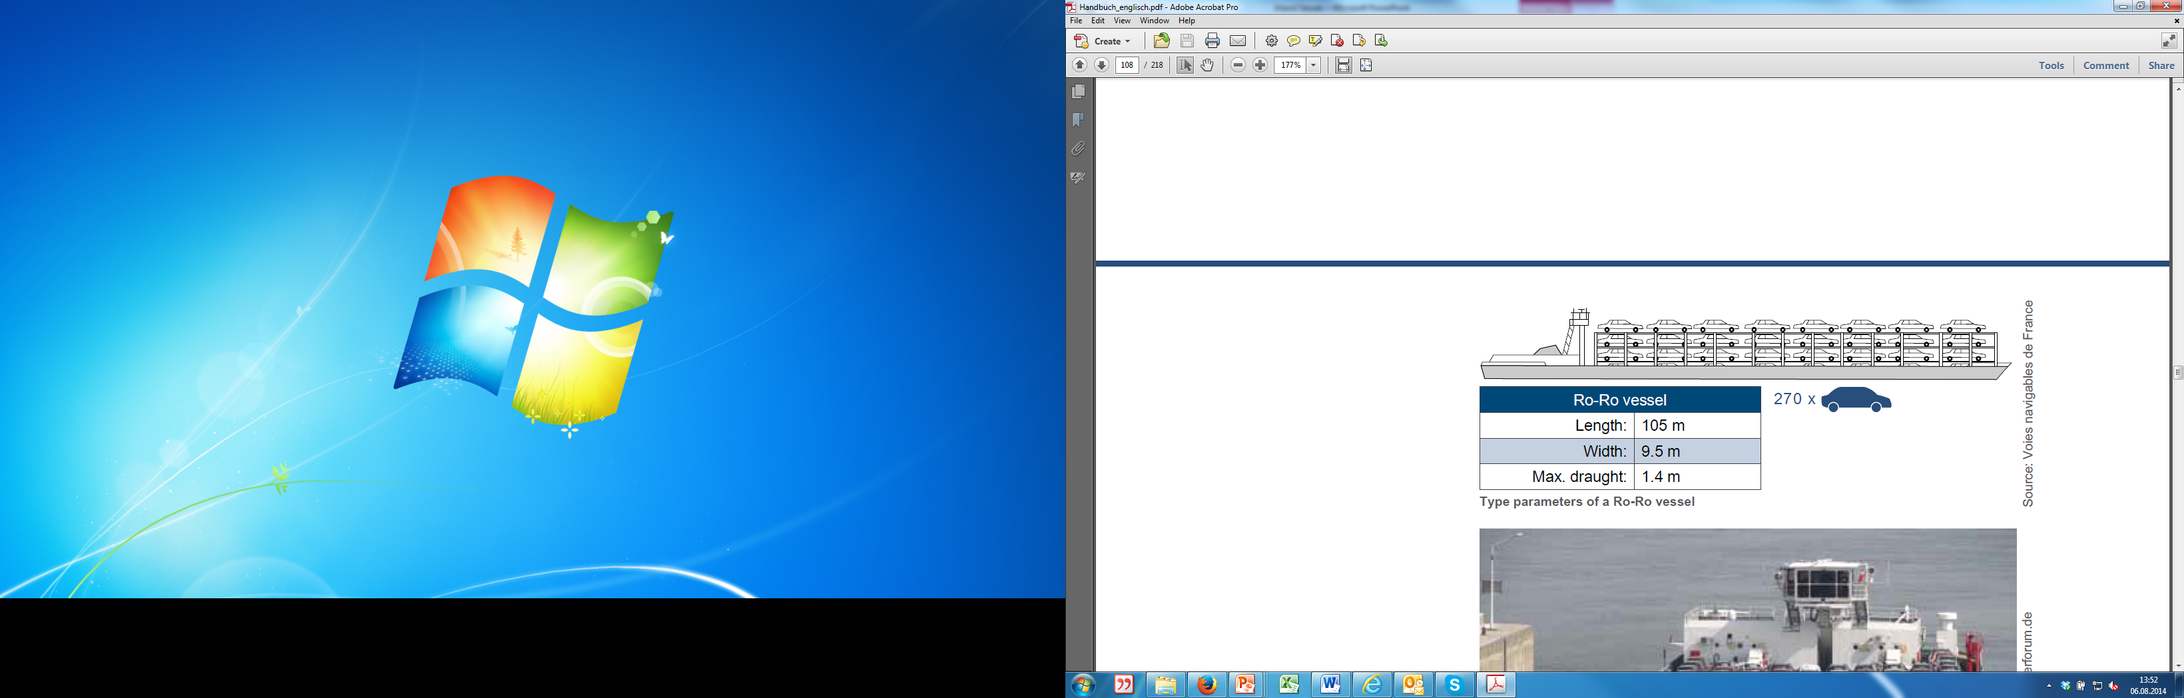
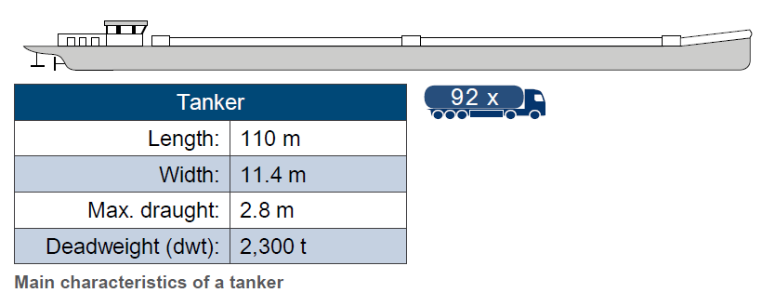
Types of Vessels according to cargo type
Types of Vessels
dry cargo vessels:
tanker:
container vessel:
Ro-Ro vessel:
source: Voies navigables de France
source: Voies navigables de France
source: viadonau
source: Voies navigables de France
Notes:
Dry cargo vessels can generally carry between 1,000 and 2,000 tons of goods and are often used on the Danube in coupled formations or pushed-coupled convoys.
Tankers on the Danube have an average deadweight of around 2,000 tons. As is the case with navigation of dry cargoes, the transport of liquid goods on the Danube is carried out primarily by pushed convoys.
Ro-Ro-vessels means that the goods being transported can be loaded and unloaded using their own motive power via port or vessel ramps.
Manual on Danube Navigation page 115-118

Slide 33
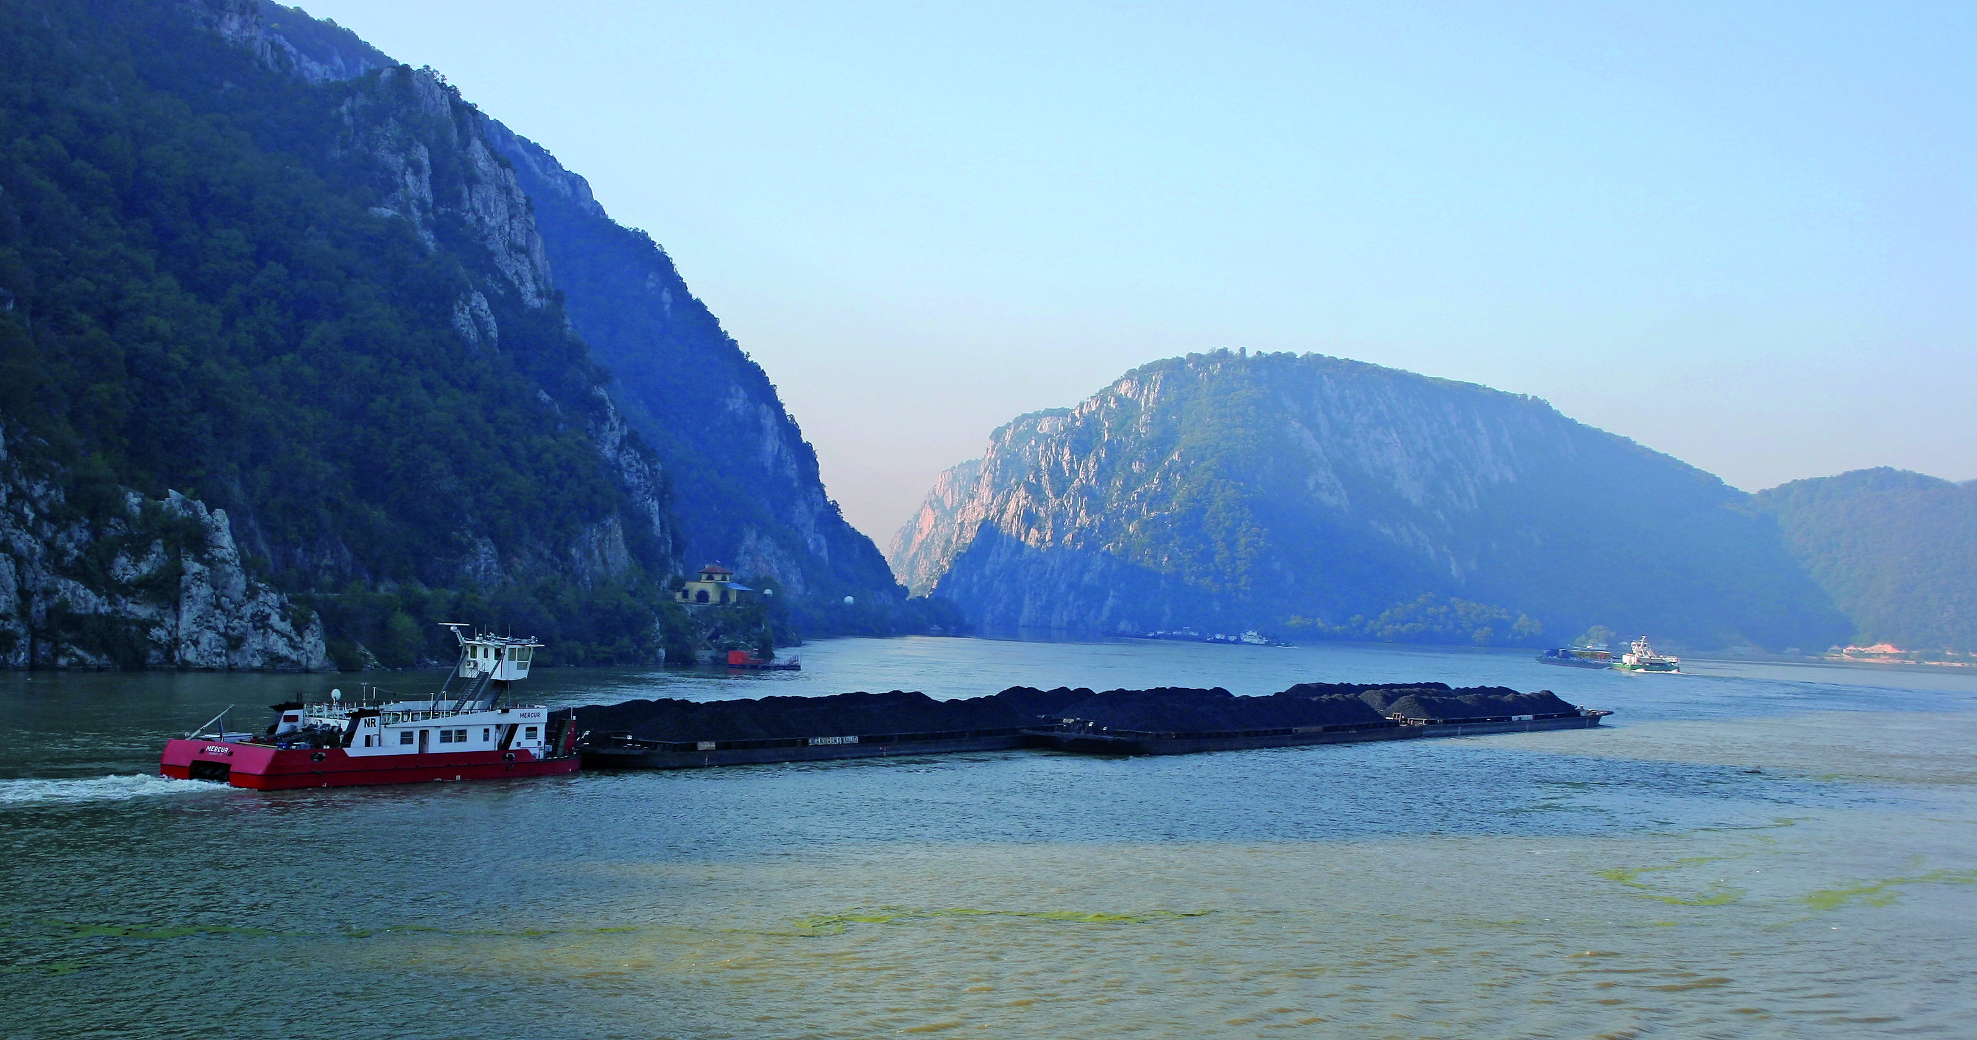
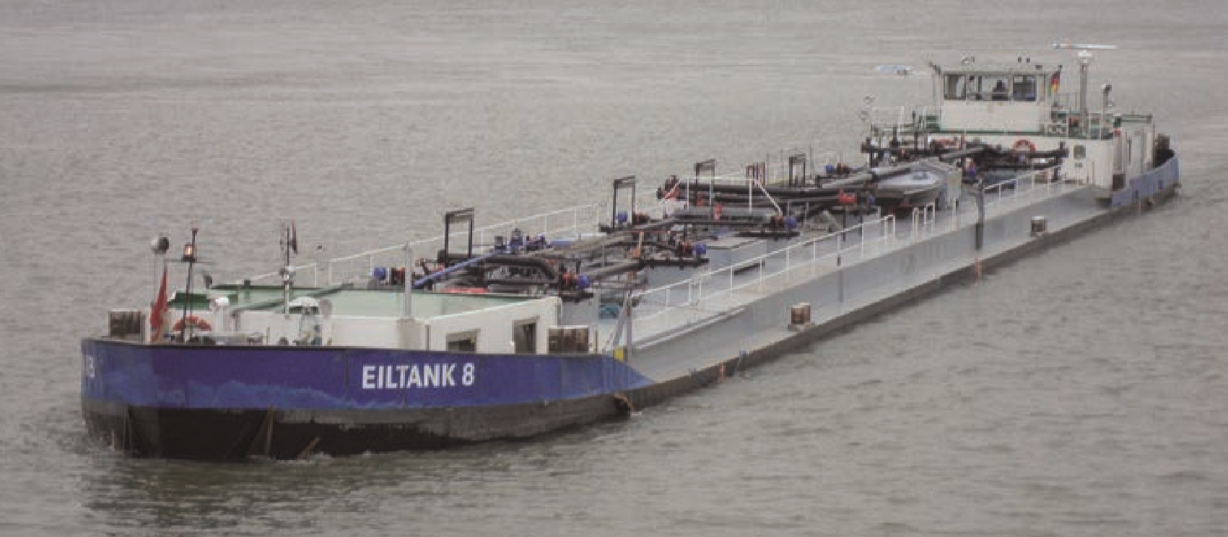
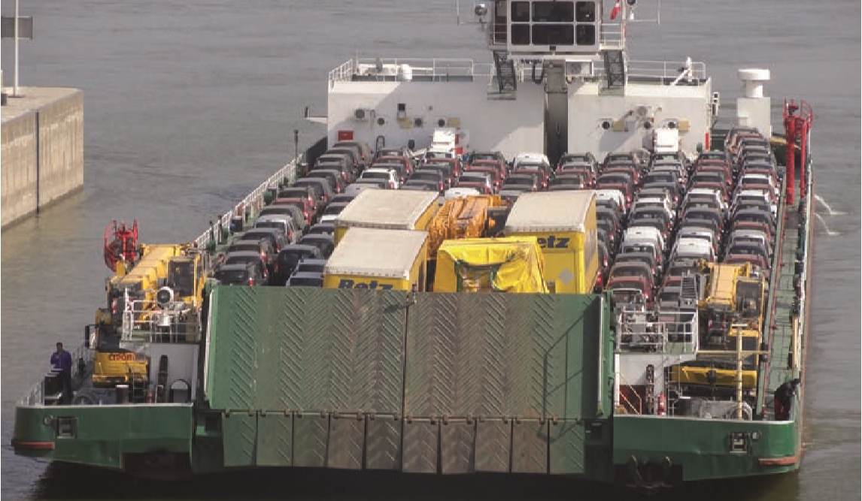
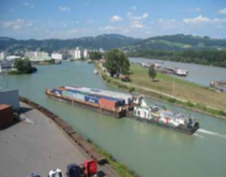
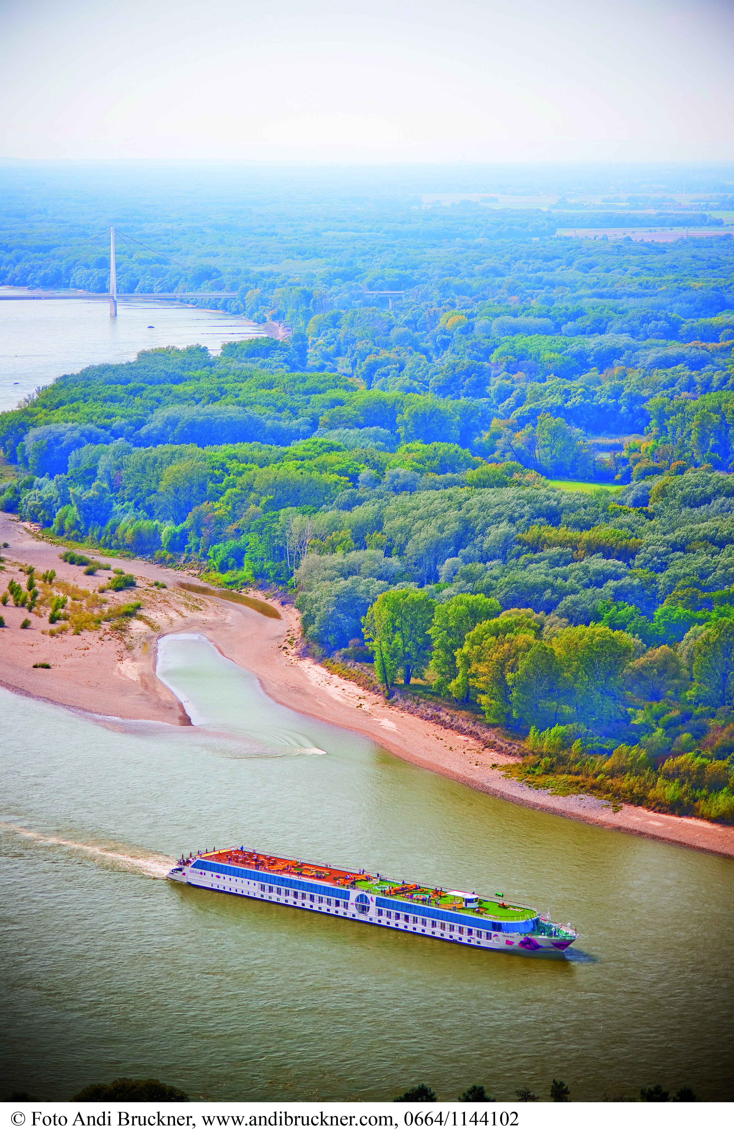
Types of Vessels according to cargo type
Types of Vessels
Picture: navrom
Dry cargo vessels
to transport dry cargo like wood, grain and ore
Tanker
for liquid goods such as mineral oil, derivates,
chemical products or liquid gas
Ro-Ro vessels
for goods loaded and unloaded by using
their own motive power (cars or heavy cargo)
Container vessels
for the transport of containers
Passenger vessels
such as cruise or cabin vessels
Source: C.N.F.R. NAVAROM S.A. Galati
Quelle: viadonau
Picture: Reederei Jaegers
Source: helmut1972, www.binnenschifferforum.de
Source: helmut1972, www.binnenschifferforum.de
Picture: Willi Betz
Picture: Andi Bruckner
Source: via donau
Source: viadonau / Andi Bruckner
source: via donau
Notes:
Dry cargo vessels are used for transporting a wide variety of goods including log wood, steel coils, grain and ore.
Tankers transport various types of liquid goods, such as mineral oil and derivates (petrol, diesel, heating oil), chemical products acids, bases, benzene, styrene, methanol) or liquid gas. The majority of the liquid goods are dangerous goods which are transported using a special tanker vessel unit equipped with the appropriate safety devices.
Ro-Ro-vessels means that the goods being transported can be loaded and unloaded using their own motive power via port or vessel ramps. The most important types of goods transported in this way include passenger cars, construction and agricultural machinery, articulated vehicles and semi-trailers.
Container vessels are ships constructed specifically for the transport of containers and are currently used primarily in the Rhine region.
The Danube has become significantly more attractive in recent years even for longer river cruises along its whole stretch between the Main-Danube-Canal and its Black Sea estuary. As a logical consequence of this trend, the number of new passenger vessels is also rising.
Manual on Danube Navigation page 115-118.
Picture: C.N.F.R. NAVAROM S.A. Galati, : helmut1972, www.binnenschifferforum.de, viadonau, viadonau / Andi Bruckner, Manual on Danube Navigation p 119, 125, 117, 118

Slide 34
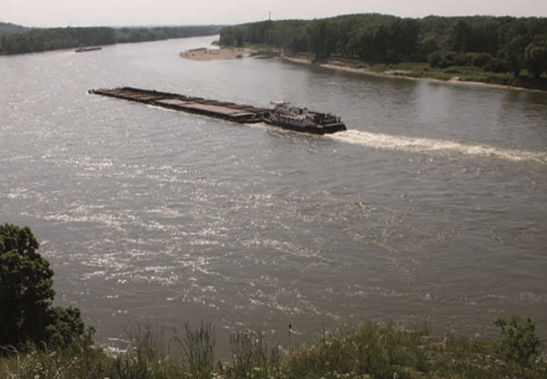
Pushed Convoys
Types of Vessels
picture: via donau
equipped with:
pusher – motorized vessel used for pushing
pushed lighter(s) – non-motorized, firmly attached to the pushing unit
coupled formation:
motor cargo vessel as pushing unit
pushed lighters coupled on its sides
picture: via donau
source: viadonau
Notes:
Pushed convoys usually consists of a pusher and one or more non-motorized pushed lighters or pushed barges. They are firmly attached to the pushing unit, and at least one unit is positioned in front of the pushing craft. A coupled formation or side-by-side formation consists of one motor cargo vessel with one or two lighters or barges coupled on its sides.
Manual on Danube Navigation page 112.
Picture: viadonau, https://fotos.viadonau.org, Manual on Danube Navigation p 112.

Slide 35
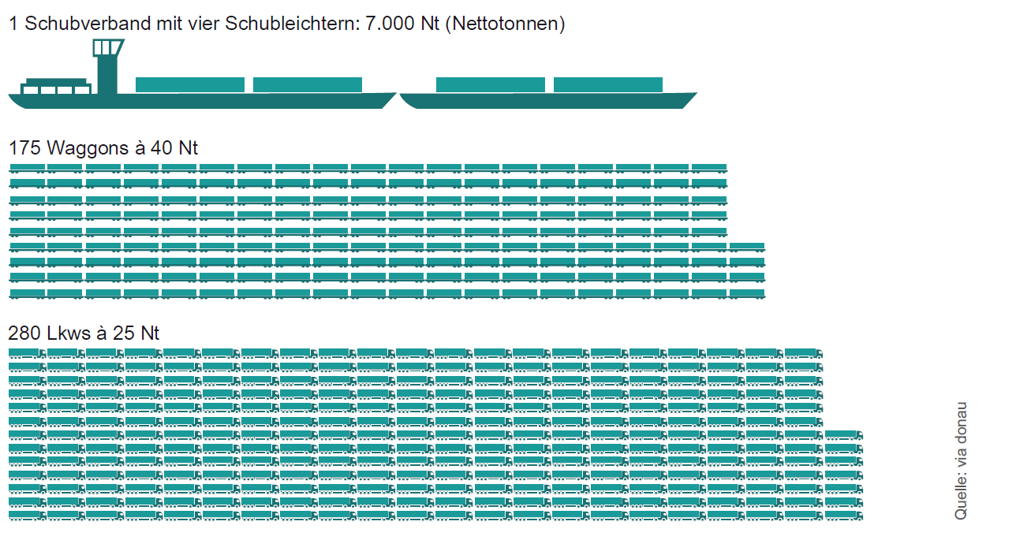
Bulk Freight Capacity (4-unit convoy)
Types of Vessels
Notes:
Compared to other land transport modes, Danube navigation offers a significantly higher transport capacity per transport unit. For instance, a single convoy with 4 pushed lighters can transport around 7,000 tons of goods – equivalent to the cargo carried by 175 railcars (with 40 net tons each) or 280 trucks (with 25 net tons each).
Manual on Danube Navigation page 18-19.
Picture: viadonau, Manual on Danube Navigation p 19

Slide 36
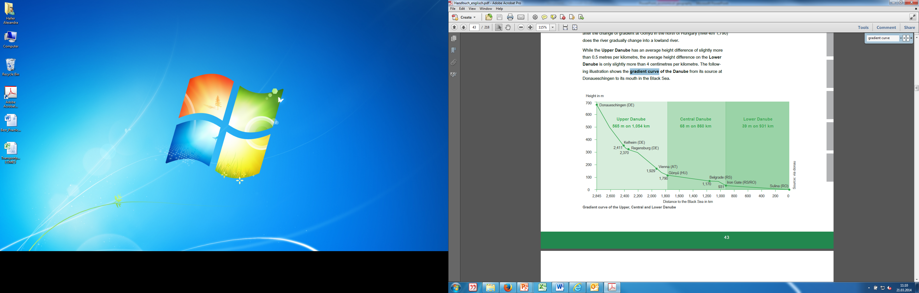
Navigability of the Danube
Types of Vessels
4-unit convoy navigable from Passau to the Black Sea Region
9-unit convoy:
  15.750 tons capacity = 630 trucks = 394 railway wagons
  navigability: central and lower Danube
Lower Danube:
  pushed convoys with up to 16 pushed lighters possible
source: via donau
source: via donau
Notes:
A pushed convoy consisting of one pusher and four non-motorized can navigate the whole stretch of the Danube between the German port of Passau and the Black Sea.
Even more impressive is the transport capacity of a 9-unit convoy like those used on the Central and Lower Danube. A convoy of this kind can carry remarkable 15,750 tons of cargo and can therefore replace 630 trucks or 394 railway wagons. Convoys comprising up to 16 pushed lighters are possible on the lower reach of the Danube due to the width of the waterway and the fact that there are no limitations caused by locks.
Manual on Danube Navigation page 113-114.
Picture: viadonau, Manual on Danube Navigation p 41.

Slide 37
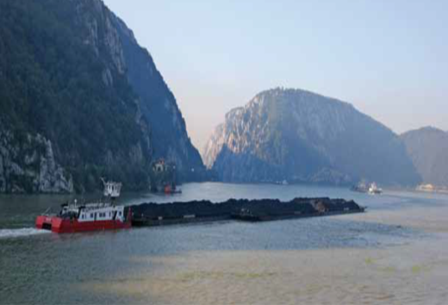
The Danube Fleet
Types of Vessels
mainly large shipping companies
87 % non-self-propelled units
13 % self-propelled units
pushed convoys Ø 20 years old
motor cargo vessels Ø between 18 and 32 years old
Quelle: C.N.F.R. NAVAROM S.A. Galati
source: via donau
Notes:
Large shipping companies remain dominant on the Danube. This is the opposite of the situation on the Rhine, where small „one-ship-companies“, i.e. private vessel owner operators are predominant.
Due to the relatively low gradient of the Danube in its middle and lower stretches these large shipping companies use large pushed convoys to transport bulk cargo.
The share of cargo space on non-self-propelled units on the Danube fleet stood at around 87% at the end of 2016. In absolute figures, this amounted to 1,668 pushed lighters with an average tons deadweight of almost 1,300.
In contrast to the Rhine region, the proportion of self-propelled units with a cargo hold account for 13% of the Danube fleet and is hence relatively low.
Manual on Danube Navigation page 125-126.
Picture: C.N.F.R. NAVAROM S.A. Galati,Manual on Danube Navigation p 125

Slide 38
Digression: Transport Services on the Danube
The Blue Pages: navigator for transport services along the Danube
online portal: www.blue-pages.at
Rhine: www.bonapart.de
e.g. DDSG- Donau-Dampfschifffahrtsgesellschaft
  Former Austrian state shipping company, was biggest west and middle European inland waterway shipping company for a long period of time
  privatized in 1991: separated in DDSG Blue Danube (passenger vessels) and First-DDSG (freight transport)
source: via donau
Notes:
On the mentioned website you will find a overview of shipping companies and logistics service providers along the Danube, and on www.bonapart.de along the Rhine.
http://www.danube-logistics.info/the-blue-pages/
https://www.ddsg-blue-danube.at/
https://www.bonapart.de/nachrichten.html

Slide 39
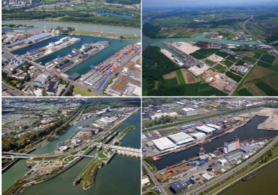
Digression: Development Trends
green ports – sustainable port management
  shore power stations
specialized ports
  for certain goods
  e.g. heavy cargo ports for high & heavy cargo
  transhipment or liquid bulk goods
cooperation of ports
  e.g. ports in the same geographical region
  Cooperation of Austrian Danube Ports (IGÖD)
Picture: Hafen Linz AG, Ennshafen, Hafen Wien, Rhenus Donauhafen Krems
IGÖD: Hafen Linz, Ennshafen,
Hafen Krems, Hafen Wien
source: viadonau
Notes:
In addition to multi-purpose ports, specialized ports also exist which focus their business on a particular type of cargo. The specialization of a port to specific transport sectors can lead to competitive advantages. The port may specialize in a specific type of cargo on the basis of greater demand for such goods and/or increased cargo volumes in the hinterland of the port.
Green Ports, i.e. sustainable port management, is a trend which has become increasingly more predominant in the field of port development over the last few years. Green ports aim to strike a balance between environmental impact and economic interests. Together with the development of ports, the concept Green Ports also includes a total redesign of logistics chains.
Example:
Shore-side electricity facilities at the port allow vessels to source the power they need, even when their engines are switched off. Besides cutting fuel consumption, this leads to a reduction in pollutant, odor and noise emissions at the port. Efforts are therefore under way at European level to continue expanding the provision of shore-side electricity facilities.
In order to maintain a hold in an ever changing environment, both competition and cooperation are required. Co-opetition, a combination of competition and cooperation is consistent with this approach. For this reason, ports in the same geographical region often cooperate with each other in areas such as marketing and locational development.
Manual on Danube Navigation page 101-103.
Picture: Hafen Linz AG, Ennshafen, Hafen Wien, Rhenus Donauhafen Krems, Manual on Danube Navigation 2013 p 92, 93

Slide 40
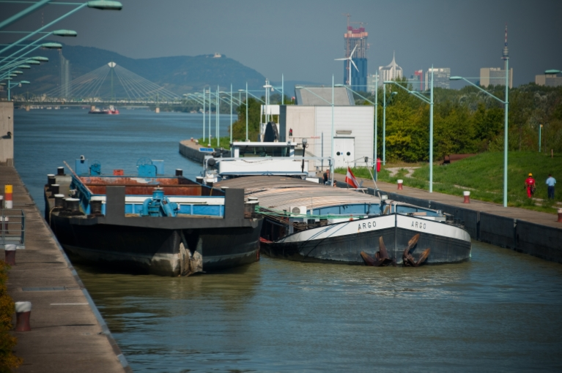
Quiz
Danube ports
What is another name for motor cargo vessels?
self-propelled vessels
pushed convoy
pushed lighter
listless
source via donau
Notes:
Picture: viadonau, https://fotos.viadonau.org

Slide 41
Internet Research final exercise
Do an internet research on the worlds biggest inland waterway port.
Write down the most important basic information, such as:
    Country/city
    Surface, capacity
    Cargo types
    (in Mio. to.)
    Etc. transhipment
Compare the results of your internet search with data of Austrian ports. What are similarities? What are discrepancies?
Create a PowerPoint, a flipchart etc.
Notes:
This exercise could be an individual exercise or to be solved in groups of max. 5 people.
Duration: 20 minutes

Slide 42
Sources
viadonau (2019): Manual on Danube Navigation, Vienna.
Order: http://www.viadonau.org/fileadmin/user_upload/Manual_on_Danube_Navigation.pdf
viadonau (2021): Annual Report on Danube Navigation in Austria 2021, Vienna.
INeS Danube information platform on intermodal inland navigation
Homepage: http://www.ines-danube.info/?lang=en
Wiener Hafen und Lager Ausbau- und Vermögensverwaltung, GmbH & Co KG
URL: www.hafen-wien.com
Duisburger Hafen AG
URL: www.duisport.de
National Company "Maritime Ports Administration" S.A. Constantza
URL: www.portofconstantza.com

Slide 43

Further Information
We hope our set of slides has met your expectations!
- you are free to use, adapt and share this slides and to use it for your lectures.
For questions and feedback please do not hesitate to contact us:
rewway@fh-steyr.at
Further set of slides are available at:
http://www.rewway.at/en/teaching-materials/bundles/
Maybe you are interested in booking a Transport School Lab, a guest lecture or an excursion?
http://www.rewway.at/en/services/

