Slide 1
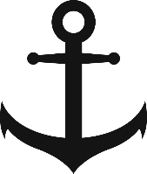
Objective: Increase attractiveness of the European inland waterways

