Slide 1
How to work with this learning material
Power Point
  The following power point presents The international waterway of the Danube. The slides are shortly described in the notes below and you can also find the link to the source if you need further information.
Reader
  In addition to the power point presentation, you can also use the reader provided on our platform. It’s more detailed and can be used as a script for your lessons.
Links
  You can also find the sources of our presentation and reader in the links section of the relevant bundled teaching material.
Videos and exercises
    There are also different videos and exercises used as sources in this presentation. You can find these videos as well as a variety of exercises separately in the corresponding section of the relevant bundled teaching material.
    https://www.rewway.at/en/teaching-materials/bundles/the-international-waterway-of-the-danube/

Slide 2
Learning objectives
After working through this content, the learners know…
Facts and figures about the European waterways, as well as the modal split.
The Danube waterway and the industries domiciled next to the Danube, the largest ports, and the strengths, weaknesses, chances and risks of the Danube waterway.
The Rhine waterway and the transported goods on the Rhine, as well as the port of Duisburg and Rotterdam.
The Rhine-Main-Danube Corridor and a comparison between the Danube and the Rhine.
Target group
Secondary schools
Vocational school students
University students as an introduction in inland navigation.

Slide 3
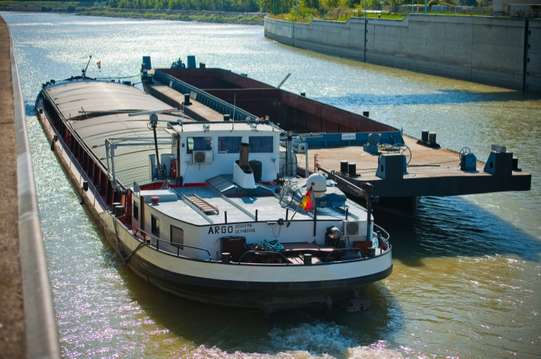
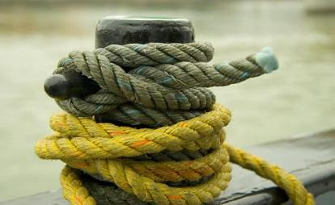



The international waterway of the Danube
Notes:
This set of slides contains geographical and economic geographical information about the Danube (corridor) and compares the Danube with the Rhine.
Picture: Manual on Danube Navigation p 106
https://fotos.viadonau.org

Slide 4
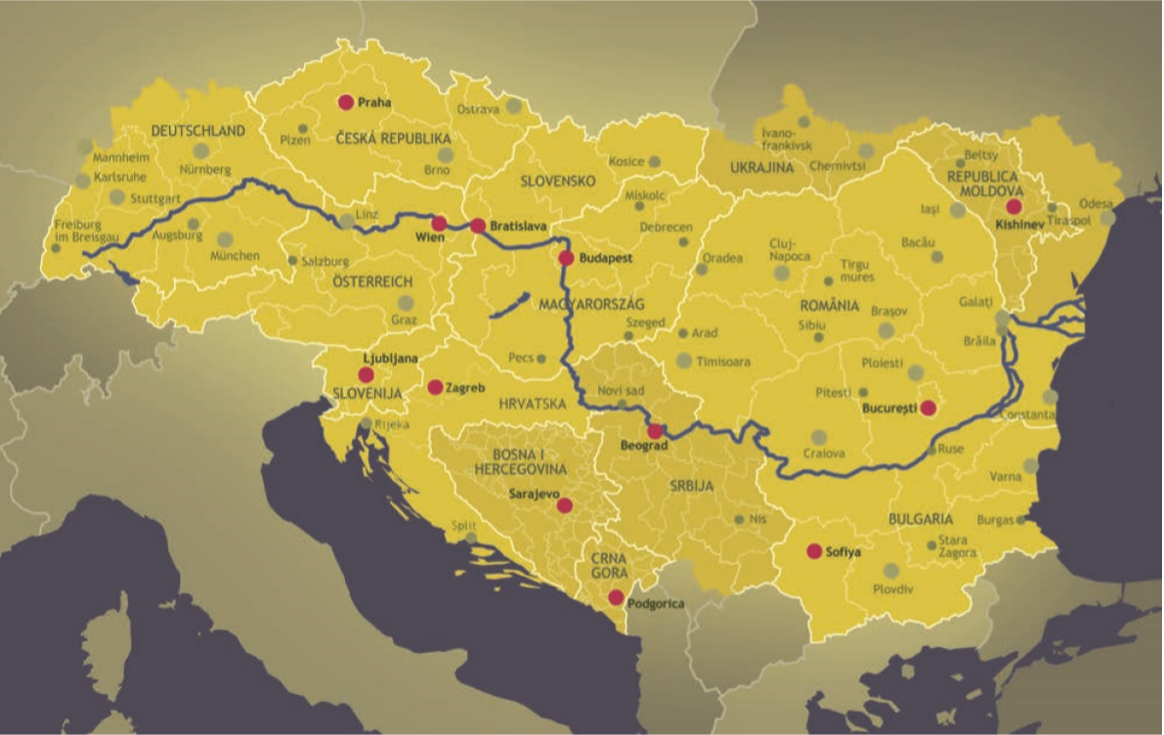
Warm-Up
The International Waterway of the Danube
Picture: INTERACT
How many riparian states does the Danube have?
Why is the Danube important for the Austrian economy?
Notes:
The questions mentioned in the slide above can be used as a warm up exercise for the topic “The international waterway of the Danube”. The aim is to discuss the questions in plenum with students. Answers to the questions will be provided during the presentation. Therefore, the questions can be discussed again at the end of the presentation.
Discussion questions (5-10 Minute Discussion):
The Danube flows through which countries? Germany, Austria, Slovakia, Hungary, Croatia, Serbia, Romania, Bulgaria, Moldova, Ukraine
How many riparian states does the Danube have? 10
Which markets are important for the Rhine? Container, weight-intensive goods, chemicals
Are there differences between the Rhine and Danube waterway? Yes, for example the Danube is longer than the Rhine, the average transport distance on the Rhine is shorter than on the Danube and the total transport volume of the Rhine is higher than the one of the Danube
Input- possible topics of discussion:
Infrastructure
Waterways in Europe
Markets
riparian states
Availability of the Danube
Picture: INTERACT, Manual on Danube Navigation p 29

Slide 5
The international waterway of the Danube
Rhine-Main-Danube-Corridor
The Danube Waterway
European Waterways
The Rhine Waterway

Slide 6
European Waterways
> 20.000 km of navigable waterways
2020 EU-wide 5,8 % of modal split
  percentage strongly differs among the European countries
Netherlands: highest share of inland navigation in the EU (around 41,6 %)
about 505 million tons of goods/year were transported on the inland waterways of the European Union (2020)
source: eurostat
source: eurostat, Port of Rotterdam, via donau
Notes:
In the 28 countries of the European Union, waterways made up a 6.0% share of the modal split in 2017 – which means that 6.0% of all freight ton- kilometers were handled on waterways. This share differs sharply in the individual EU states. The Netherlands, for instance, have important seaports and a highly integrated inland waterway network which is divided into small sections. This results in the highest inland navigation share of the 28 EU countries (44.7% in 2017).
Source:
Manual on Danube Navigation, p 21
Eurostat: “Modal Split of Freight Transport”: URL: https://ec.europa.eu/eurostat/statistics-explained/index.php?title=Freight_transport_statistics_-_modal_split [2020]

Slide 7
European Waterways
France: longest waterways
in Europe (8.800 km)
Netherlands: most dense waterways
(6.000 km, serving all parts of the country)
2/3 of European waterway transports include the Rhine
Rhine-Main-Danube-Corridor is the most
important inland waterway in Europe
Notes:
Inland navigation has an important role in Germany, France, Belgium and the Netherlands. France disposes over the longest navigable waterways (about 8,000km) in Europe. The Netherlands disposes over 6,000 km of waterways and therefore the densest waterway network in Europe. In combination with numerous maritime ports the Netherlands disposes over the highest share of inland waterway navigation in Europe. The Rhine river is one of the most important rivers in Europe, despite the fact, that only 885 km are navigable. It participates on 2/3 of all European inland waterway transports. The Rhine-Main-Danube corridor is the most important inland waterway corridor in Europe.
Sources: Van Deleur, Caroline: Platina F&F General (2012), online unter URL: http://de.slideshare.net/carolinevandeleur/platina-ff-general-14427068 [30.03.2020]; Indexmundi, online unter URL: http://www.indexmundi.com/map/?t=10&v=116&r=eu&l=en [30.03.2020]

Slide 8
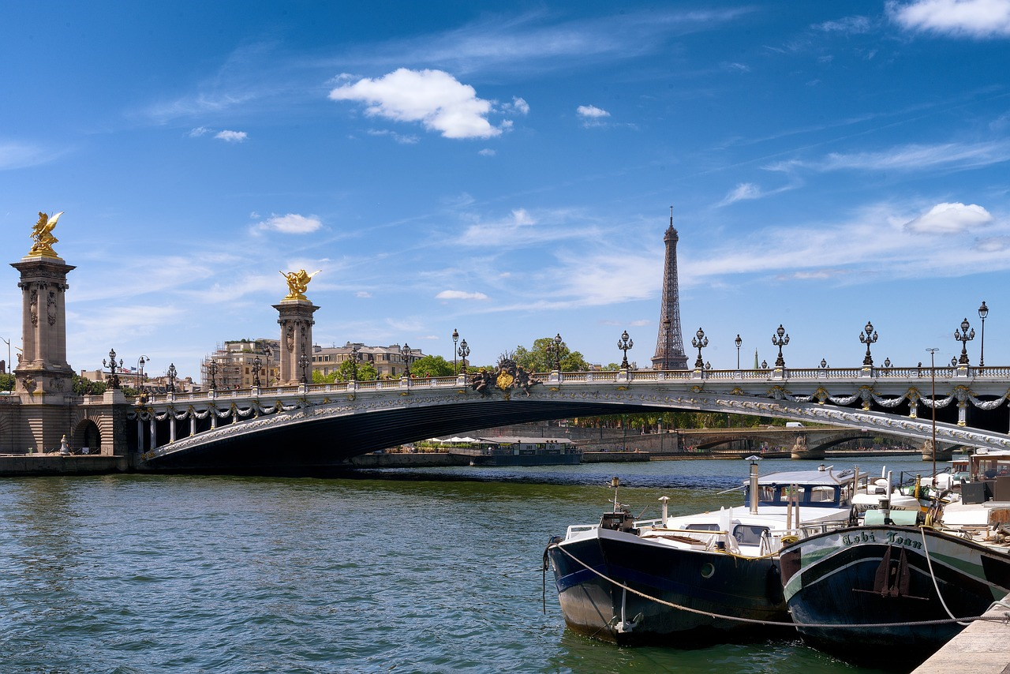
Quiz
European Waterways
Which country in Europe has the longest waterways?
Netherlands
Germany
France
Italy
source:pixabay
Notes:
Which country in Europe has the longest waterways?
France with 8.800 km.
Picture: www.pixabay.com

Slide 9
Agenda
The international waterway of the Danube
Rhine-Main-Danube Corridor
The Danube Waterway
European Waterways
The Rhine Waterway

Slide 10
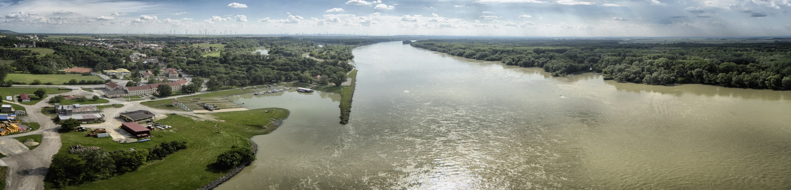
Danube – Data and Facts
The Danube Waterway
second largest river in Europe
2.845 km long
  navigable: 2.415 km
connects 10 riparian states
from the Black Forest to the Black Sea
Quelle: via donau
Notes:
The Danube rises in the Black Forest in Germany and empties into the Black Sea in Romania and the Ukraine. The river has a length of 2,845 km –2,415 km are navigable – and connects ten riparian states. The Danube has been a significant European trading route since early history. It is also an important source of energy and drinking water, as well as a precious and unique recreational space and habitat.
Quelle: Manual on Danube Navigation 41
Picture: viadonau, https://fotos.viadonau.org

Slide 11

Danube – Data and Facts
The Danube Waterway
Danube passes through 10 riparian states
Austrian segment: 351 km
Romanian segment of 1.075 km largest share
river basin covers 801.463 km²
  important transport mode
  important source of energy- and drinking water
  valuable recreational and living environment
source: via donau
Danube Bordering States
source: via donau
Notes:
With a total length of 1,075 kilometers, Romania has the largest share of the Danube, representing almost a third of the entire length of the river. Thereof, some 470 kilometers make up the common state border with Bulgaria. Moldova has the smallest share of the Danube with only 550 meters. Four countries, i.e. Croatia, Bulgaria, Moldova and Ukraine, are situated on only one bank of the river.
The river basin district is the catchment area where all water from land surfaces, streams and ground water sources drains into the respective river. The river basin of the Danube covers 801,463 km². It lies to the west of the Black Sea in Central and South-Eastern Europe.
Source: Manual on Danube Navigation page 39-40.
Picture: viadonau, Manual on Danube Navigation page 38

Slide 12

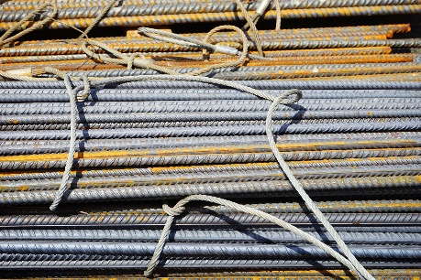


Danube Region
The Danube Waterway
Source: via donau
90 Mio. inhabitants
transport mode for industrial sites along the Danube
steel, paper, petroleum and chemical industries along with the mechanical engineering and automotive industry are to be
found within the catchment area of the Danube
fertile soil
→ agricultural raw materials
→ transport on the Rhine-Main-Danube-Corridor to the ports
Source: pixabay
source: istockphoto.com/David Jones
Source: pixabay
source: via donau
Notes:
With approximately 90 million inhabitants, the Danube region is of great economic interest. The focus of this economic development lies in the capital cities of the Danube countries.
The Danube is of particular importance as a transport mode for the industrial sites that are located along the Danube corridor. Bulk freight capacity, the proximity to raw material markets, large free transport capacities and low transport costs all add up to make inland navigation the logical partner for resource-intensive industries.
Due to its fertile soil, the Danube region is an important area for the cultivation of agricultural raw materials. These not only serve to ensure the sustainable provision of the conurbations in the vicinity of the Danube, but are also transported along the logistical axis of the Danube to be further processed.
Source: Manual on Danube Navigation page 146.

Slide 13
Danube
The Danube Waterway
transport volume: 39.3 million tons (2017)
average transport distance: 600 km
navigability of the Danube in 2018: 100,00 %
→ no barriers because of ice or floods necessary
important markets:
  Iron ores and metal wastes
  agricultural and forestry products
  mineral oil products
Notes:
In 2017 the transport volume on the Danube was 39.3 million tons (mean transport distance approx. 600 km) compared to 186 million tons on the Rhine (mean transport distance approx. 200 km). Inland navigation is a vital transport mode for the steel industry. Iron ore accounts for example for 25-30% of the total transport volume shipped on the Austrian stretch of the Danube. Due to their heavy weight, semi-finished and finished goods such as steel coils can also be transported economically using inland navigation.
The demand and, therefore, also the flow of goods from the agriculture and forestry sector can fluctuate greatly from one year to the next. Agriculture is dependent to a great extent on weather conditions (precipitation, temperature, days of sunshine per year).
Petroleum products from the mineral oil industry account for a large share of total transport volumes on the Austrian stretch of the Danube and therefore constitute a key market. In the Danube region there are many refineries located either on or near the waterway.
The Danube connects the four major sea ports (Amsterdam, Rotterdam, Antwerp in the north and the Black Sea port of Constantza in the south). The 12 ports with the highest turnover, with a cargo turnover of over 1 million tons in 2017, are located along the Danube:
Ismail (UA)
Linz (AT)
Russe (BG)
Lom (BG)
Smederovo (SRB)
Bratislava (SK)
Tulcea (RO)
Budapest (HU)
Regensburg (DE)
Wien (AT)
Galati (RO)
Calarasi (RO)
Sources: viadonau, “Manual on Danube Navigation”, p 17, 20, 154, 161-163
Picture: based on Donaukommission (2019), Statistik der Donauschifffahrt für die Jahre 2016-2017

Slide 14
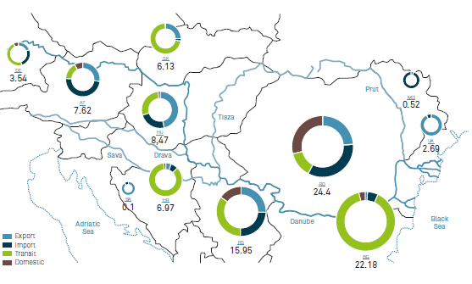
Transport volumes on the entire Danube (2020)
The Danube Waterway
source: via donau
Notes:
In 2020, a total of around 34.0 million tons of goods were transported on the entire
navigable Danube between Kelheim and the Black Sea, its tributaries and the
Danube-Black Sea Canal. This corresponds to a slight decrease of 2.2 million tons
or 6.1% compared to 2019.
In terms of individual countries, the largest transport volumes were achieved by far
in Romania with 24.4 million tons, Bulgaria with 22.2 million tons and Serbia with
16.0 million tons. Trailing behind were Hungary with 8.5 million tons, Austria with
7.6 million tons, Croatia with 7.0 million tons, Slovakia with 6.1 million tons, Germany
(local government districts of the Upper Palatinate/Lower Bavaria) with 3.5 million
tons, Ukraine with 2.7 million tons*, Moldova with 0.5 million tons and Bosnia-Herzegovina,
which is connected indirectly to the Danube via the Sava, with 0.1
million tons.
These size ratios show that considerably higher transport volumes are achieved on
the lower and middle Danube than on the upper Danube. For comparison: in 2020,
more than three times the quantity generated in Austria was shipped in Romania.
Source: Annual report of viadonau, 2021, p 44, 45
Picture: Annual report of viadonau, 2021, p 44

Slide 15
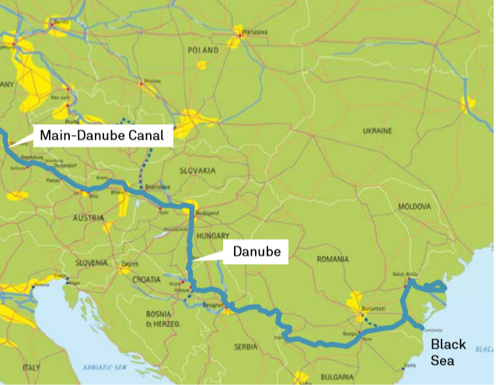
Danube Ports
The Danube Waterway
connection between the modes of transport
waterway, road and rail
modern logistical hubs
three major ports on the Danube:
  Izmail (Ukraine)
  Linz (Austria)
  Galati (Romania)
Source: viadonau, Inland Navigation Europe
Quelle: via donau, Observatory of European inland navigation
Notes:
Inland ports enable the combination of the transport modes waterway, road and rail. Working in multimodal logistics chains, rail and road act as partners to waterway transport by enabling the pre- and end-haulage of inland navigation transports. The ports are the important interfaces in this regard.
Over recent decades, the Danube ports have underwent profound transformation from conventional inland ports to modern logistics hubs. In addition to basic services such as transhipment and storage, ports offer an extensive range of logistics services, including commissioning, distribution, project logistics and many more. As production sites as well as cargo collection and distribution centers, they are extremely well integrated into regional economies and contribute substantially to economic growth and the creation of employment.
The three most important Danube port locations in terms of transshipment are Izmail (Ukraine), Linz (Austria) und Galaţi (Romania). The seaport at Constanţa (Romania) has a particular status. It is connected to the Danube via the Danube-Black Sea Canal and plays an important role as a transhipment gateway to the Black Sea, thereby facilitating trade with Asia, the Middle East and the Black Sea region.
Source: viadonau, “Manual of the Danube Navigation”, S. 15, 16
Picture: Inland Navigation Europe, Manual of Danube Navigation p 44

Slide 16
Legal Framework
Belgrade Convention
„Convention Regarding the Regime of Navigation on the Danube “
signed by all Danube riparian states
main objectives:
  to safeguard the freedom of navigation on the Danube
  obligation of Danube states to maintain their sections of the Danube waterway
the implementation of the Belgrade Convention is supervised by the Danube Commission which is based in Budapest.
Notes:
The Convention Regarding the Regime of Navigation on the Danube was signed by all Danube riparian states (‘Belgrade Convention’ of 1948). Its main objectives are to safeguard the freedom of navigation on the Danube for all states as well as to oblige the Danube states to maintain their sections of the Danube waterway to a navigable condition.
The implementation of the Belgrade Convention, together with adherence to its provisions, is supervised by the Danube Commission which is based in Budapest. The Commission is made up of the signatory states of the Belgrade Convention.
Source: Manual on Danube Navigation p 29

Slide 17
Legal Framework
Belgrade Convention
No canal and lock fees on the Danube (classification as international waterway)
Locks are carried out free of charge
Belgrade Convention → free navigation on the Danube for merchant vessels under the flags of all states of the Danube riparian states
fees have to be paid for navigating the Main-Danube Canal and the Danube-Black Sea Canal (Romania)
(national waterways are not covered by the Belgrade Convention)
source: via donau, Observatory of European inland navigation
Notes:
On the international waterways of the Danube and Rhine, no navigation charges are levied. Fees are payable for navigating the Main-Danube Canal (Germany) and the Danube-Black Sea Canal (Romania), as these are national waterways not covered by the Belgrade Convention of 1948. In this Convention on the Regulation of Navigation on the Danube, free navigation on the Danube for merchant vessels under the flags of all states was established by the Danube riparian states.
Source: viadonau, URL: http://www.viadonau.org/wirtschaft/transportachse-donau/ [27.04.2020]

Slide 18

Quiz
The Danube waterway
The Danube flows from …
West to East
East to West
North to South
South to North
Quelle: pixabay
Notes:
The Danube flows from … West to East.
Picture: www.pixabay.com

Slide 19
Agenda
The international waterway of the Danube
Rhine-Main-Danube-Corridor
The Danube Waterway
European Waterways
The Rhine Waterway

Slide 20
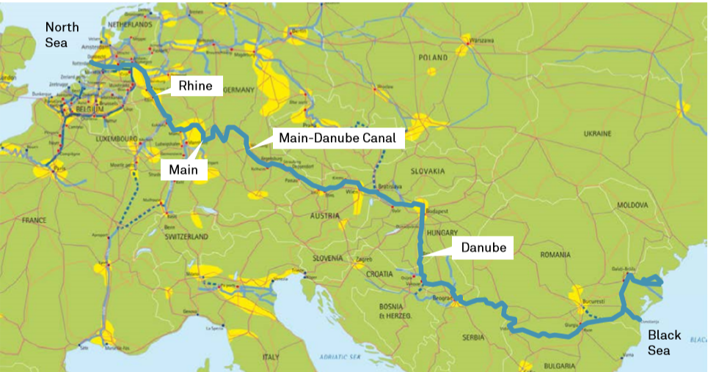
Rhine-Main-Danube Corridor
most important inland waterway axis on the European mainland
international waterway between the North Sea in the West and the Black Sea in the East
total length: 3.504 km
connects 15 countries
Main-Danube-Canal since 1992 opened to navigation
Quelle: viadonau, Inland Navigation Europe
source: via donau
Notes:
The most important inland waterway axis on the European mainland is the Rhine-Main-Danube Corridor. The Rhine and Danube river basins, which are connected by the Main-Danube Canal, are the backbone of this axis. The Main-Danube Canal was opened to navigation in 1992 and created an international waterway between the North Sea in the West and the Black Sea in the East. This waterway has a total length of 3,504 kilometres and provides a direct waterway connection between 15 European countries.
Source: Manual on Danube Navigation p 44
Picture: viadonau, Inland Navigation Europe, Manual on Danube Navigation p 44

Slide 21
Rhine-Main-Danube Corridor
Rhine vs. Danube:
Rhine-Main-Danube-Corridor is the most important European waterway
→different infrastructural preconditions:
DANUBE:
  limited ramification of Danube waterway
  bridges – 130 bridges span international
  inland navigation on the Danube is characterised by longer distances.
  RHINE:
  density of population and economic activity at Rhine
source: via donau, observatory of European inland navigation, Central Commission for the navigation of the Rhine
Notes:
The Rhine-Mine-Danube Corridor has a total length of 3,500 kilometres and it connects the port of Rotterdam (Netherlands) with the port of Constanta (Romania), connecting 15 countries in Europe.
Even though the Danube is 2.7 times longer than the Rhine, almost seven times more goods were transported on the Rhine. This is due to different infrastructural preconditions of these two inland waterways: The limited ramification of the Danube waterway enables only a spatially concentrated use, confining the Danube to a limited form of transport requiring longer pre- and end-haulage by road or rail. For this reason, inland navigation in the Danube region usually has a lower share of national modal split figures. In addition, a total of 130 bridges span the international Danube waterway. This leads to restrictions concerning the possible transport volume of inland vessels.
Furthermore, the Rhine has four main tributaries which strengthen the role of the Rhine as the most important waterway in Europe. The economic activity and the high density of population along the Rhine also supports an increased use of this inland waterway as a transport mode.
Sources:
Manual on Danube Navigation p 20,21,59
Central Commission for the navigation of the Rhine, “Inland navigation in Europe market observation – quarterly report 2016/Q1”, (2016), p.14

Slide 22
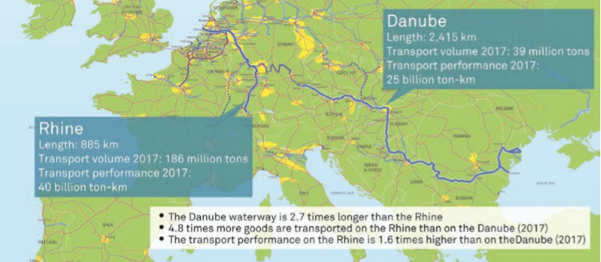
Rhine-Main-Danube Corridor
Rhine vs. Danube:
Source: viadonau, Central Comision of the Navigation on the Rhine
source: via donau, observatory of European inland navigation, Central Commission for the navigation of the Rhine
Notes:
The Rhine-Mine-Danube Corridor has a total length of 3,500 kilometres and it connects the port of Rotterdam (Netherlands) with the port of Constanta (Romania), connecting 15 countries in Europe.
Even though the Danube is 2.7 times longer than the Rhine, almost seven times more goods were transported on the Rhine. This is due to different infrastructural preconditions of these two inland waterways: The limited ramification of the Danube waterway enables only a spatially concentrated use, confining the Danube to a limited form of transport requiring longer pre- and end-haulage by road or rail. For this reason, inland navigation in the Danube region usually has a lower share of national modal split figures. In addition, a total of 130 bridges span the international Danube waterway. This leads to restrictions concerning the possible transport volume of inland vessels.
Furthermore, the Rhine has four main tributaries which strengthen the role of the Rhine as the most important waterway in Europe. The economic activity and the high density of population along the Rhine also supports an increased use of this inland waterway as a transport mode.
Sources:
Manual on Danube Navigation p 20,21,59
Central Commission for the navigation of the Rhine, “Inland navigation in Europe market observation – quarterly report 2016/Q1”, (2016), p.14
Picture: viadonau, Zentralkommission für Rheinschifffahrt, Manual on Danube Navigation p 21

Slide 23
Quiz
Rhine-Main-Danube-Corridor
How many countries does the Rhine-Main-Danube-Corridor connect?
10 c) 20
15 d) 24
Notes:
How many countries does the Rhine-Main-Danube-Corridor connect? 15
Picture: vidonau, Manual on Danube Navigation p 44

Slide 24
Agenda
The international waterway of the Danube
Rhine-Main-Danube-Corridor
The Danube Waterway
European Waterways
The Rhine Waterway

Slide 25
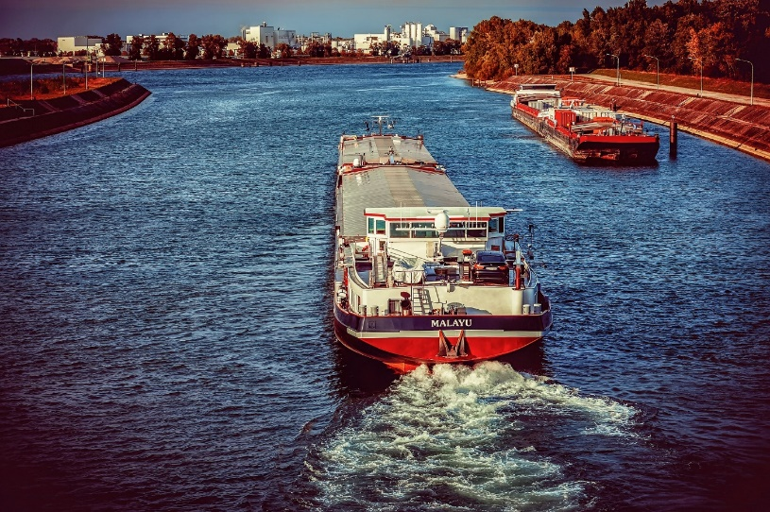
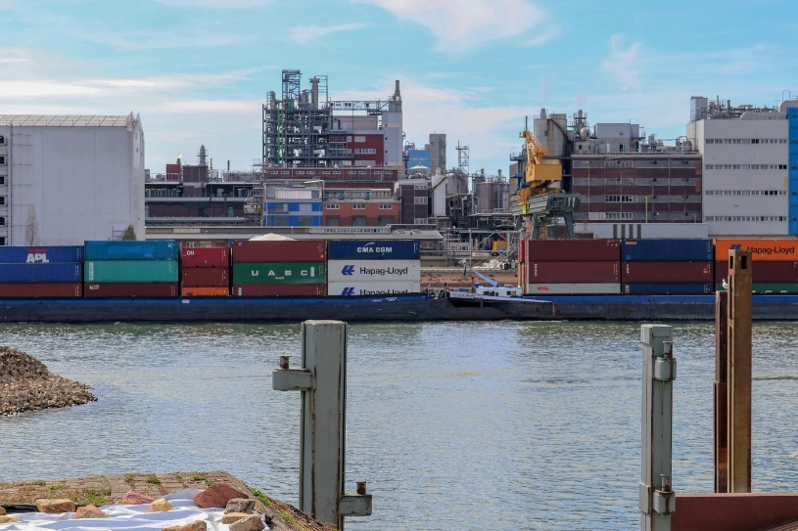
The Rhine Waterway
Quelle: pixabay
Length: 1,320 km
  navigable: 885 km
Transported volume 2017:
  186,5 million tons
Average transport distance: 200 km
Quelle: pixabay
Notes:
The route of the Rhine runs from Rotterdam (Netherlands) to Basel (Switzerland) and has a length of 885 km. In 2017, 186,5 million tons were transported on the Rhine, whereby the average transport distance was 200 kilometres.
Sources:
World wide inland navigation network, URL: http://www.wwinn.org/the-rhine [21.03.2020]
Manual on Danube Navigation p. 20, 21
Picture: www.pixabay.com

Slide 26

The Rhine Waterway
  2/3 of all goods transported on inland waterways in Europe pass through the Rhine
Notes:
Two third of all goods transported on inland waterways in Europe pass through the Rhine. This points out the importance of this inland waterway for the European economy and transport sector.
The predominant transported goods in 2017 were solid mineral fuels, petroleum products and ores. The highest amount of goods is transhiped at the port of Duisburg (inland port) and at the port of Rotterdam (maritime port).
The most important goods for transport on the Rhine are containers, weight-intensive goods and chemicals.
Sources:
World wide inland navigation network, URL: http://www.wwinn.org/the-rhine [21.03.2020]
Manual on Danube Navigation p 20, 21
Picture: own representation based on URL: http://www.wwinn.org/the-rhine [21.03.2020]

Slide 27
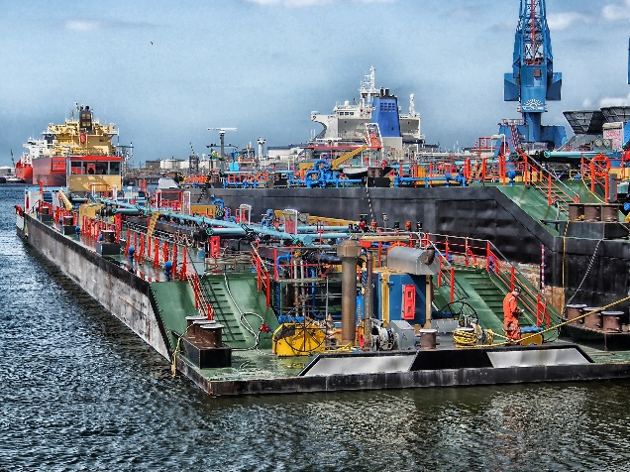
Digression: Port of Rotterdam
located in the Rhine-Meuse Delta (mouth of the Rhine, North Sea)
about 469,4 Mio. tons of freight transhipment (2019)
biggest sea port of Europe*
eight-largest sea port worldwide*
about 100 km² port area (42 km length)
385.500 employees in the mainport Rotterdam
fairway 26 m deep (=without limitation of a ships draught)
* on the basis of total cargo throughput
Further information: https://www.portofrotterdam.com/de
Quelle: pixabay
source: port of Rotterdam
Notes:
The port of Rotterdam is located in the Netherlands in the Rhine-Meuse Delta (mouth of the Rhine, North Sea). With the 100km2 port area and its 385.500 employees and a transhipment rate of 469,4 million tons in 2019, the port of Rotterdam is the largest maritime port in Europe, following Antwerp (Belgium) and Hamburg (Germany). Rotterdam is also the ninth largest maritime port of the world (regarding transhipment rate). With the 26m deep fairway, there are no limitations of a ships draught.
Source: URL: https://www.portofrotterdam.com/en/news-and-press-releases/port-of-rotterdam-throughput-amounted-to-4694-million-tonnes-in-2019 [21.03.2020].
https://www.portofrotterdam.com/sites/default/files/fakten-und-zahlen-rotterdamer-hafen_0.pdf [21.03.2020].
https://www.portofrotterdam.com/de/unser-hafen/fakten-und-zahlen/fakten-und-zahlen-zum-hafen/hafeninfrastruktur [21.03.2020].
Picture: www.pixabay.com

Slide 28
Comparison
Rhine and Danube
Rhine
Danube
25 billion tkm carryings (2017)
39 Mio. t
freight volume (2017)
2.414 km length
885 km length
186 Mio. t
freight volume (2017)
40 billion tkm carryings (2017)
The Danube is 2,7 times longer
On the Rhine 4.8 times more goods are transported
Danube traffic is characterised by longer distances
carrying is 1.6 times higher
Source: own representation, based on viadonau
The Rhine-Main-Danube inland waterways as the most important
transport route for environmentally friendly transports
Notes:
The navigable part of the Rhine is 885 km long and consisted of a freight volume of 186 million tons in 2017. The transport performance was of 40 billion ton kilometres in 2017. In comparison the Danube is 2,415 km long and consisted of a freight volume of 39 million tons and a transport performance of 25 billion ton kilometres in 2017. The Danube waterway is 2.7 times longer than the Rhine. Nevertheless, 4.8 times more goods were transported on the Rhine than on the Danube in 2017. The transport performance was 1.6 times higher than on the Danube. Danube traffic is characterized by longer distances than transports on the Rhine.
Source: Manual on Danube Navigation p 20-21

Slide 29
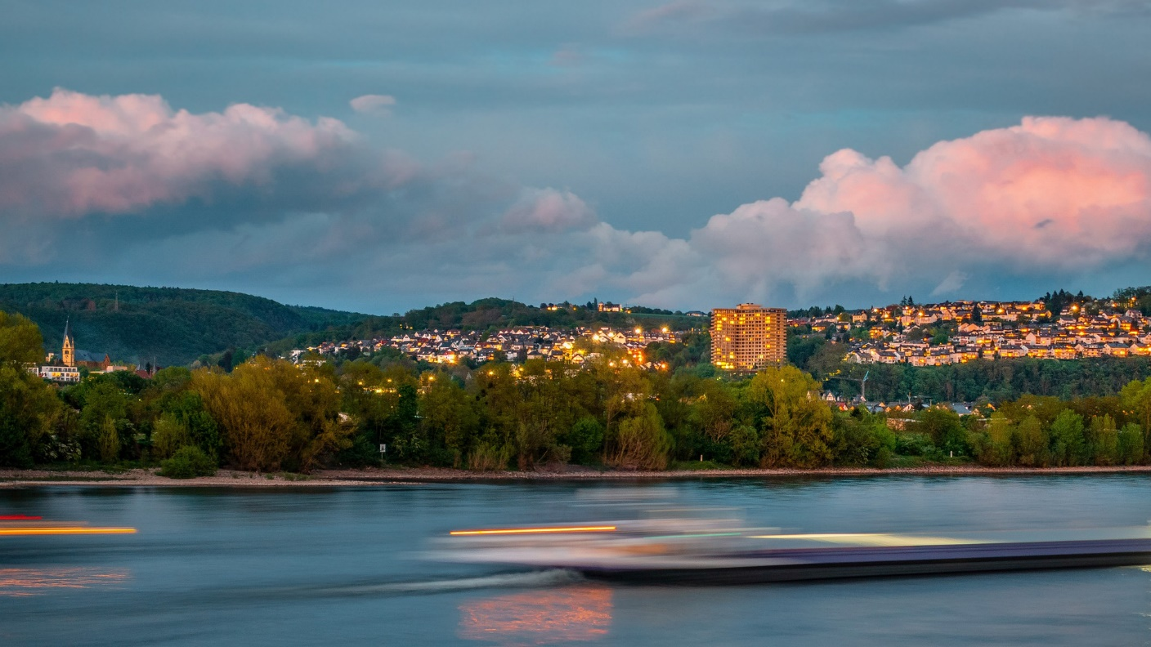
Quiz
The Rhine waterway
How long is the average transport distance at the Rhine?
100 km c) 300 km
200 km d) 400 km
Quelle: pixabay
Notes:
How long is the average transport distance at the Rhine?
200 km
Picture: www.pixabay.com

Slide 30
ABC-list final exercise
Create an ABC-list of the most important terms of the topic “The international waterway of the Danube”
Take a piece of paper, write down the ABC on the longer side of the paper.
Afterwards, you write down important terms of the topic “The international waterway of the Danube” for every letter. In each line you write down terms, which start with the letter of that line for example S … shipping charges.
At the end you will have a collection of all the important terms regarding the topic “The international waterway of the Danube”
Notes:
This exercise is suitable as a individual exercise.
Duration: 30-40 minutes

Slide 31
4-field-matrix final exercise
Take a big sheet of paper or a flipchart and separate it into 4 parts.
Each of the fields is allocated to one of the thematic fields of the presentation
  Waterways in Europe
  The Danube Waterway
  Rhine-Main-Danube-Corridor
  The Rhine Waterway
Fill in the thematic blocs with everything you remember about the subject. It could be content from this presentation or other things you learned at school, or read somewhere else.
After finishing present the results to your colleagues.
Europe?
Danube?
Rhine-Main-Danube-Corridor?
Rhine?
Notes:
This exercise is suitable for groups with up to 7 participants.
Duration: 20 minutes

Slide 32
Sources
Eurostat: “Modal Split of Freight Transport”: URL: https://ec.europa.eu/eurostat/statistics-explained/index.php?title=Freight_transport_statistics_-_modal_split [2020]
viadonau (2019): Manual on Danube Navigation, Vienna.
Order or download: http://www.viadonau.org/en/newsroom/publications/manual-on-danube-navigation/
viadonau (2021): Danube Navigation in Austria–
Annual Report 2021, Vienna.
Download : http://www.viadonau.org/en/newsroom/publications/folders/
INeS Danube information platform on intermodal inland navigation
Homepage: http://www.ines-danube.info/?lang=en
Van Deleur, Caroline: Platina F&F General (2012), online unter URL: http://de.slideshare.net/carolinevandeleur/platina-ff-general-14427068 [30.03.2020];
Indexmundi, online unter URL: http://www.indexmundi.com/map/?t=10&v=116&r=eu&l=en [30.03.2020]
World wide inland navigation network, URL: http://www.wwinn.org/the-rhine [21.03.2020]
Manual on Danube Navigation
https://www.portofrotterdam.com/de/unser-hafen/fakten-und-zahlen/fakten-und-zahlen-zum-hafen/hafeninfrastruktur
Central Commission for the navigation of the Rhine, “Inland navigation in Europe market observation – quarterly report 2016/Q1”, (2016)

Slide 33


Further Information
We hope our set of slides has met your expectations!
- you are free to use, adapt and share this slides and to use it for your lectures.
For questions and feedback please do not hesitate to contact us:
rewway@fh-steyr.at
Further set of slides are available at:
http://www.rewway.at/en/teaching-materials/bundles/
Maybe you are interested in booking a Transport School Lab,
a guest lecture or an excursion?
http://www.rewway.at/en/services/

